Slide 1


Add: 4615-15, GROUND FLOOR, GALI SHAHTARA,, AJMERI GATE, DELHI-110006
E-mail : rahulsakhuja@yahoo.com
TEL o. : 011-23215050, PAN No.ALYPS4894D
CLIENT : ………………
SAFETY EXPERTS
A UNIT OF SHIVA INDUSTRIAL CORPORATION

Slide 2
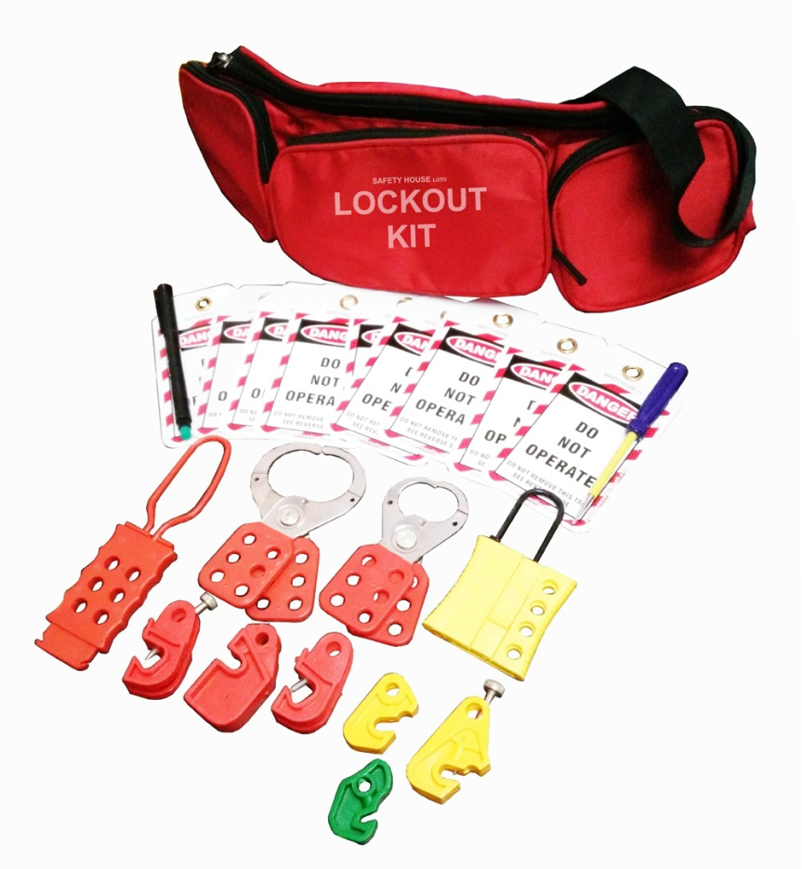
Safety EXPERTS
A UNIT OF SHIVA INDUSTRIAL CORPROTION
Item code - US-Waist-Pouch-3P-Kit-1 –- Rs.2,250/-
Lockout Waist Pouch having 3 pocket - Red - 1 pc
Lockout Tag – 10 pcs
Dielectric OSHA Padlock – 2 pcs.
Vinyl coated Hasp – Small – 1 pc
Vinyl coated Hasp – Premier – 1 pc
Dielectric Hasp with 6 holes – 1 pc
Slider Hasp with 4 holes – 1 pc
MCB Lockout different models – 6 pcs.
Screw Driver – 1 pc
Writing marker pen - 1
Add: 4615-15, GROUND FLOOR, GALI SHAHTARA,, AJMERI GATE, DELHI-110006
E-mail : rahulsakhuja@yahoo.com TEL . : 011-23215050, Mob. No.9811048483

Slide 3
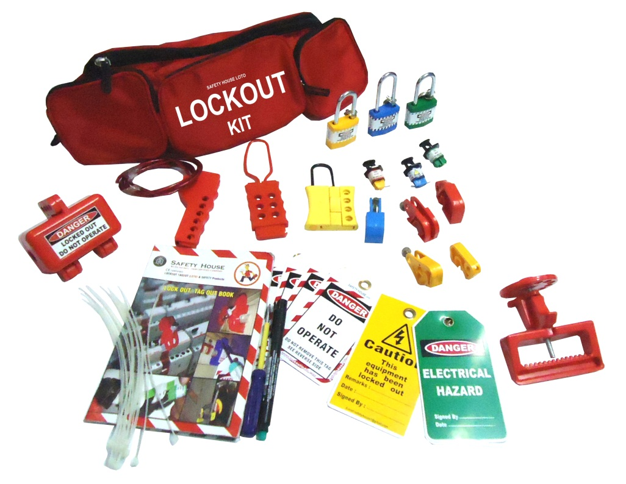
Safety EXPERTS
A UNIT OF SHIVA INDUSTRIAL CORPROTION
Item code - US-Waist-Pouch-3P-Kit-2 – Rs.2100/-
Lockout Waist Pouch having 3 pocket - Red - 1 pc
Lockout Tag – 5 pcs
Lockout Guide Book – 1 pc
Dielectric Padlock – 3 pcs.
Slider Hasp with 4 holes – 1 pc
Dielectric Hasp with 6 holes – 1 pc
Plug Lockout – 1 pc
MCB Lockout different models – 5 pcs.
Pin Type MCB Lockout – 3 pcs
MCCB Lockout – 1 pc
Screw Driver – 1 pc
Writing marker pen - 1
Add: 4615-15, GROUND FLOOR, GALI SHAHTARA,, AJMERI GATE, DELHI-110006
E-mail : rahulsakhuja@yahoo.com TEL . : 011-23215050, Mob. No.9811048483

Slide 4
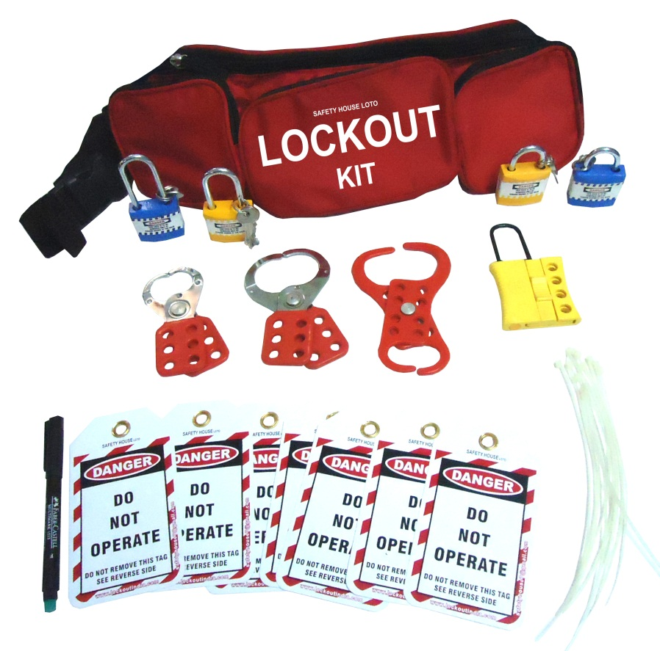
Safety EXPERTS
A UNIT OF SHIVA INDUSTRIAL CORPROTION
Item code - US-Waist-Pouch-3P-Kit-3 – Rs.1,400/-
Lockout Waist Pouch having 3 pocket - Red - 1 pc
Lockout Tag – 10 pcs
Dielectric Padlock – 4 pcs.
Slider Hasp with 4 holes – 1 pc
Double Jaw Hasp – 1 pc
Vinyl coated Hasp – Small – 1 pc
Vinyl coated Hasp – Premier – 1 pc
Lockout Ties – 10 pcs
Writing marker pen - 1
Add: 4615-15, GROUND FLOOR, GALI SHAHTARA,, AJMERI GATE, DELHI-110006
E-mail : rahulsakhuja@yahoo.com TEL . : 011-23215050, Mob. No.9811048483

Slide 5
Safety EXPERTS
A UNIT OF SHIVA INDUSTRIAL CORPROTION
Item code - US-Waist-Pouch-3P-Kit-3 – Rs.1,400/-
Lockout Waist Pouch having 3 pocket - Red - 1 pc
Lockout Tag – 10 pcs
Dielectric Padlock – 4 pcs.
Slider Hasp with 4 holes – 1 pc
Double Jaw Hasp – 1 pc
Vinyl coated Hasp – Small – 1 pc
Vinyl coated Hasp – Premier – 1 pc
Lockout Ties – 10 pcs
Writing marker pen - 1
Add: 4615-15, GROUND FLOOR, GALI SHAHTARA,, AJMERI GATE, DELHI-110006
E-mail : rahulsakhuja@yahoo.com TEL . : 011-23215050, Mob. No.9811048483

Slide 6
Safety EXPERTS
A UNIT OF SHIVA INDUSTRIAL CORPROTION
Item code - US-Waist-Pouch-3P-Kit-3 – Rs.1,400/-
Lockout Waist Pouch having 3 pocket - Red - 1 pc
Lockout Tag – 10 pcs
Dielectric Padlock – 4 pcs.
Slider Hasp with 4 holes – 1 pc
Double Jaw Hasp – 1 pc
Vinyl coated Hasp – Small – 1 pc
Vinyl coated Hasp – Premier – 1 pc
Lockout Ties – 10 pcs
Writing marker pen - 1
Add: 4615-15, GROUND FLOOR, GALI SHAHTARA,, AJMERI GATE, DELHI-110006
E-mail : rahulsakhuja@yahoo.com TEL . : 011-23215050, Mob. No.9811048483

Slide 7
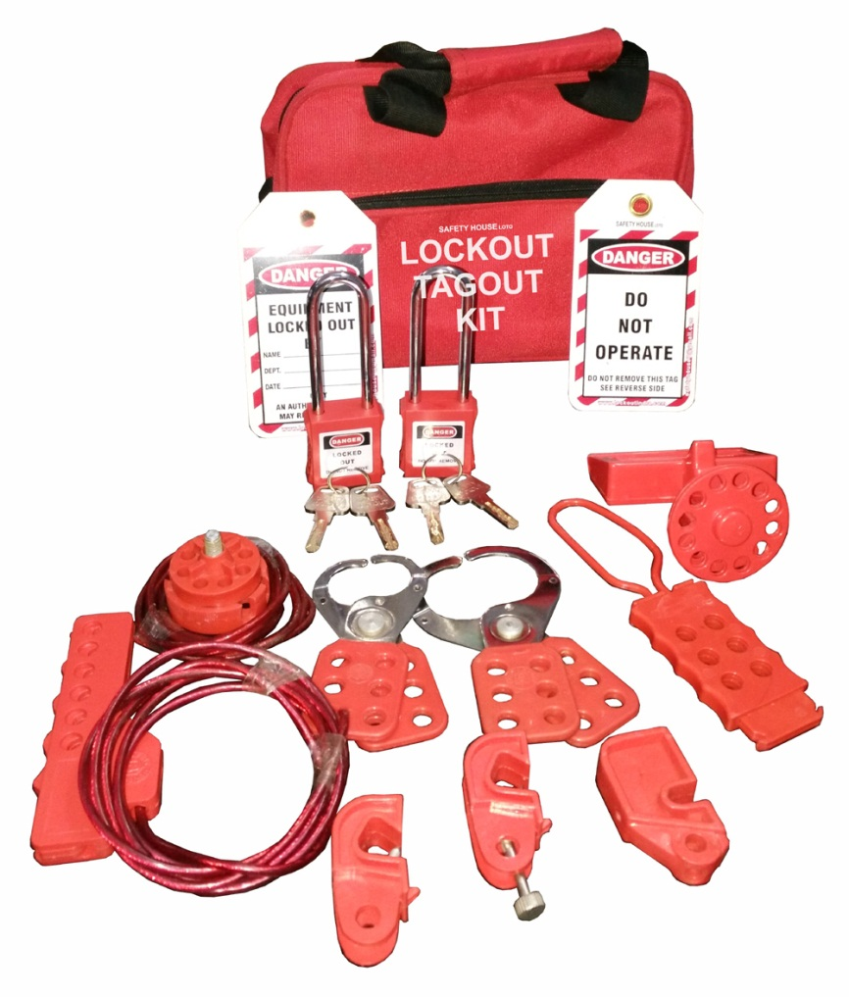
Safety EXPERTS
A UNIT OF SHIVA INDUSTRIAL CORPROTION
Item code - US-Red-Bag-Kit-1 – Rs.2,400/-
Lockout Bag - Red - 1 pc
Lockout Tag – 10 pcs
Dielectric OSHA Padlock with extra long shackle – 2 pcs.
Vinyl coated Hasp – Small – 1 pc
Vinyl coated Hasp – Premier – 1 pc
Dielectric Hasp with 6 holes – 1 pc
Scissor Cable Lockout– 1 pc
Top Cable Lockout – 1 pc
MCB Lockout different models – 3 pcs.
MCCB Lockout – 1 pc
Add: 4615-15, GROUND FLOOR, GALI SHAHTARA,, AJMERI GATE, DELHI-110006
E-mail : rahulsakhuja@yahoo.com TEL . : 011-23215050, Mob. No.9811048483

Slide 8
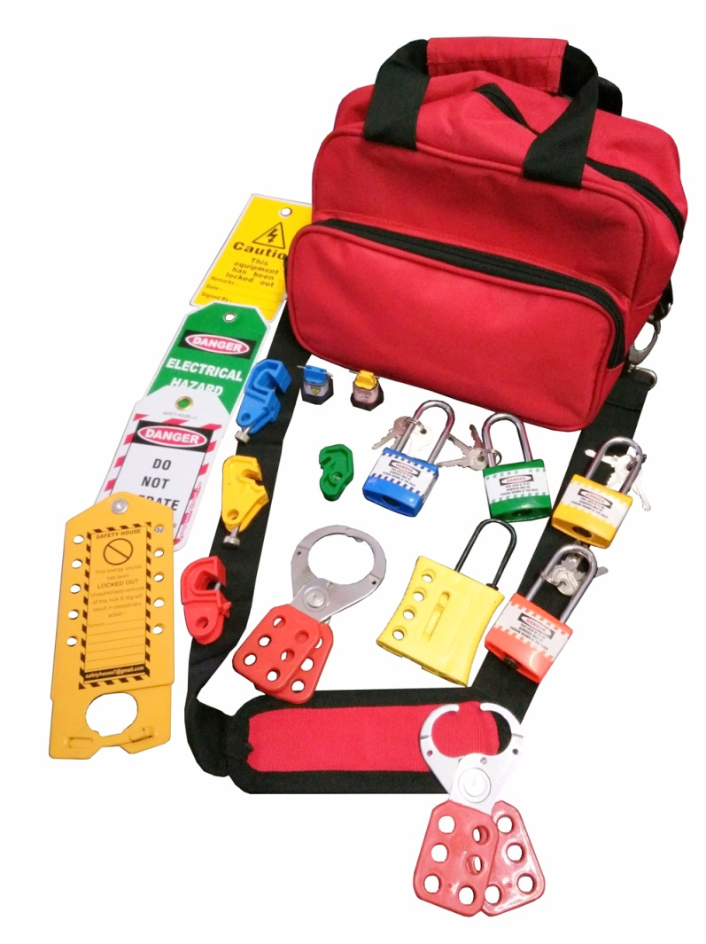
Safety EXPERTS
A UNIT OF SHIVA INDUSTRIAL CORPROTION
Item code - US-Red-Bag-Kit-2 – Rs. 2000/-
Lockout Bag - Red - 1 pc
Lockout Tag – 5 pcs
Dielectric Padlock– 4 pcs.
Vinyl coated Hasp – Small – 1 pc
Vinyl coated Hasp – Premier – 1 pc
Slider Hasp with 4 holes – 1 pc
Scissor Cable Lockout– 1 pc
Pin Type Lockout – 2 pc
MCB Lockout different models - 4 pcs.
Labeled Hasp – 1 pc
Add: 4615-15, GROUND FLOOR, GALI SHAHTARA,, AJMERI GATE, DELHI-110006
E-mail : rahulsakhuja@yahoo.com TEL . : 011-23215050, Mob. No.9811048483

Slide 9
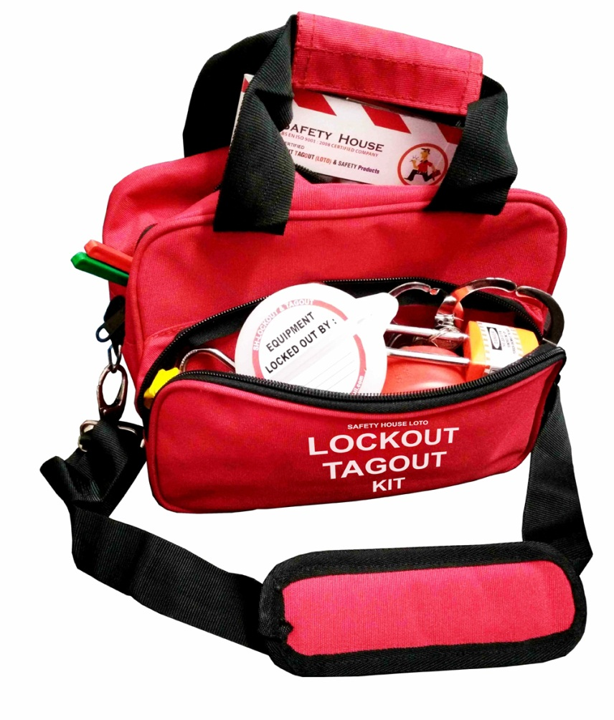
Safety EXPERTS
A UNIT OF SHIVA INDUSTRIAL CORPROTION
Item code - US-Red-Bag-Kit-3 – Rs. 2,200/-
Lockout Bag - Red - 1 pc
Lockout Tag – 5 pcs
Dielectric Padlock– 4 pcs.
Vinyl coated Hasp – Small – 1 pc
Vinyl coated Hasp – Premier – 1 pc
Slider Hasp with 4 holes – 1 pc
Scissor Cable Lockout– 1 pc
Pin Type Lockout – 2 pc
MCB Lockout different models - 4 pcs.
Push Button Lockout– 1 pc
Lockout Guide Book – 1 pc
Bar Type Lockout -1 pc
Add: 4615-15, GROUND FLOOR, GALI SHAHTARA,, AJMERI GATE, DELHI-110006
E-mail : rahulsakhuja@yahoo.com TEL . : 011-23215050, Mob. No.9811048483

Slide 10
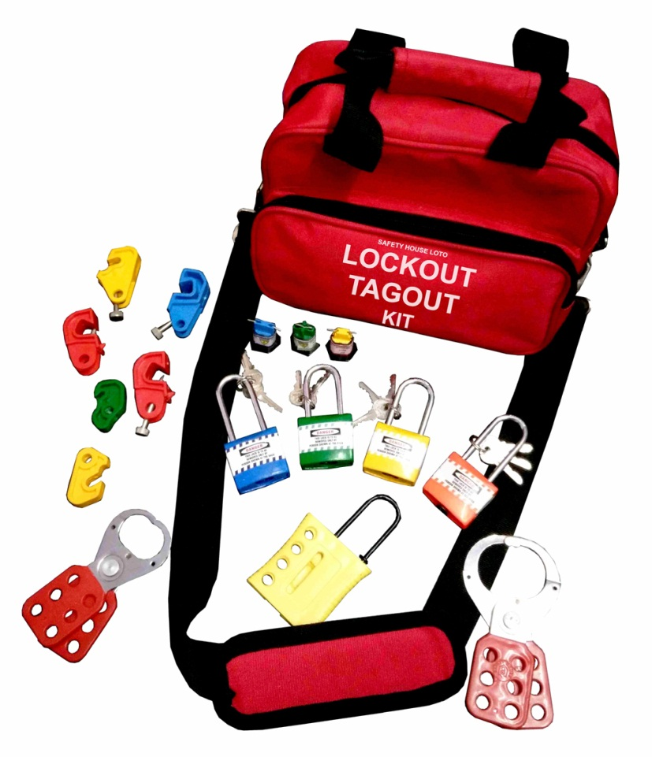
Safety EXPERTS
A UNIT OF SHIVA INDUSTRIAL CORPROTION
Item code - US-Red-Bag-Kit-4 – Rs.1,800/-
Lockout Bag - Red - 1 pc
Lockout Tag – 5 pcs
Dielectric Padlock– 4 pcs.
Vinyl coated Hasp – Small – 1 pc
Vinyl coated Hasp – Premier – 1 pc
Slider Hasp with 4 holes – 1 pc
MCB Lockout – different models – 6 pcs
Pin Type MCB Lockout – 3 pcs
Add: 4615-15, GROUND FLOOR, GALI SHAHTARA,, AJMERI GATE, DELHI-110006
E-mail : rahulsakhuja@yahoo.com TEL . : 011-23215050, Mob. No.9811048483

Slide 11
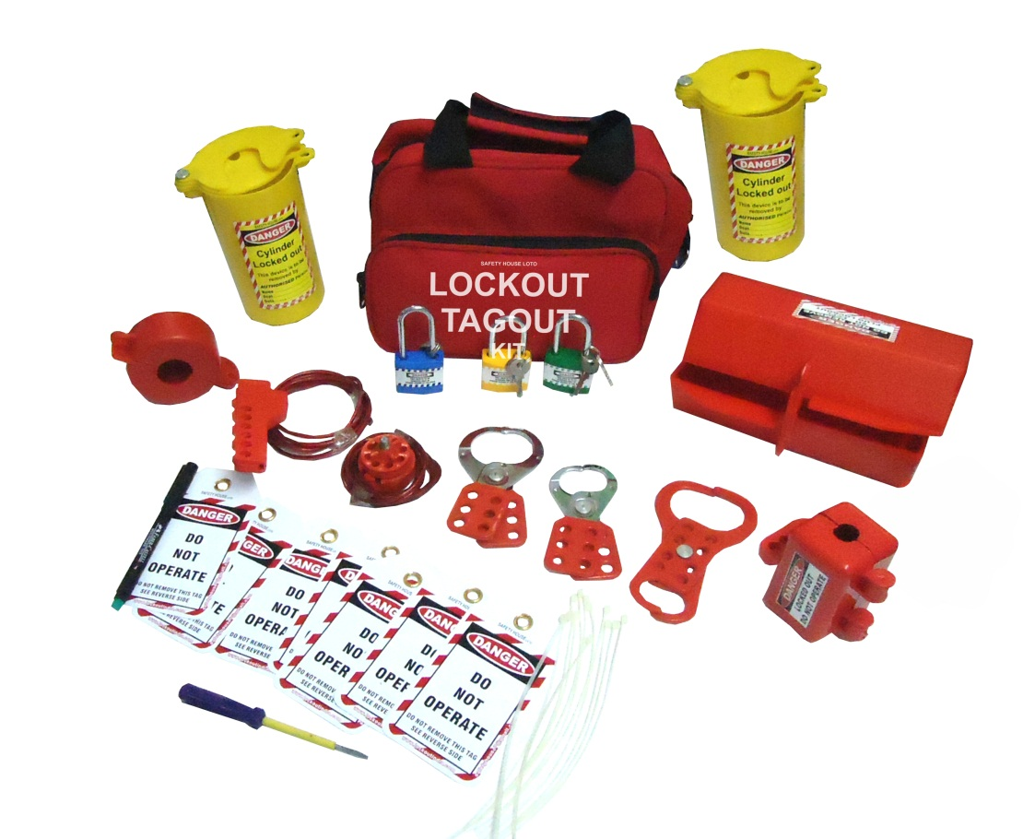
Safety EXPERTS
A UNIT OF SHIVA INDUSTRIAL CORPROTION
Item code - US-Red-Bag-Kit-6 – Rs. 2,600/-
Lockout Bag - Red - 1 pc
Lockout Tag – 10 pcs
Dielectric Padlock – 3 pcs.
Vinyl coated Hasp – Small – 1 pc
Vinyl coated Hasp – Premier – 1 pc
Double Jaw Hasp – 1 pc
Top Cable Lockout – 1 pc
Scissor type Cable Lockout – 1 pc
Cylinder Lockout – 2 pc
Plug Lockout – Small – 1 pc
Plug Lockout – Large – 1 pc
Gate Valve Lockout – 25-63.5mm – 1 pc
Writing pen – 1 pc
Add: 4615-15, GROUND FLOOR, GALI SHAHTARA,, AJMERI GATE, DELHI-110006
E-mail : rahulsakhuja@yahoo.com TEL . : 011-23215050, Mob. No.9811048483

Slide 12
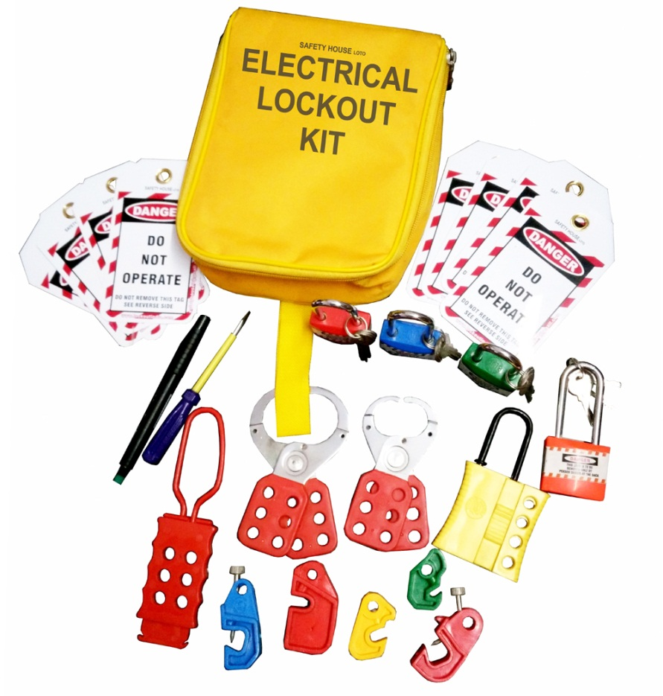
Safety EXPERTS
A UNIT OF SHIVA INDUSTRIAL CORPROTION
Item code - US-Yellow-Bag-Kit-1 – Rs.1,500/-
Lockout Bag - Yellow - 1 pc
Lockout Tag – 10 pcs
Dielectric Padlock– 4 pcs.
Vinyl coated Hasp – Small – 1 pc
Vinyl coated Hasp – Premier – 1 pc
Slider Hasp with 4 holes – 1 pc
MCB Lockout – different models – 5 pcs
Screw Driver – 1 pc
Writing Pen – 1 pc
Add: 4615-15, GROUND FLOOR, GALI SHAHTARA,, AJMERI GATE, DELHI-110006
E-mail : rahulsakhuja@yahoo.com TEL . : 011-23215050, Mob. No.9811048483

Slide 13
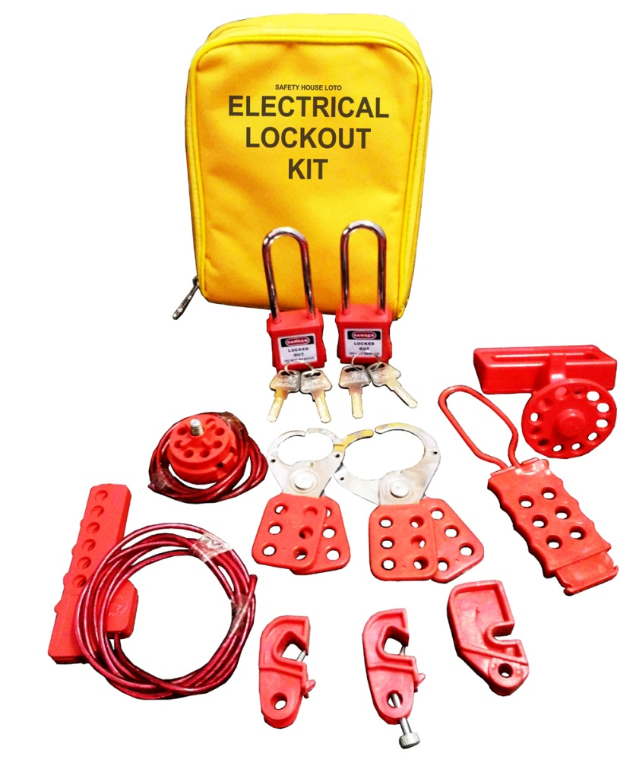
Safety EXPERTS
A UNIT OF SHIVA INDUSTRIAL CORPROTION
Item code - US-Yellow-Bag-Kit-2 – Rs.2.200/-
Lockout Bag - Yellow - 1 pc
Lockout Tag – 10 pcs
Dielectric OSHA Padlock with extra long shackle – 2 pcs.
Vinyl coated Hasp – Small – 1 pc
Vinyl coated Hasp – Premier – 1 pc
Dielectric Hasp with 6 holes – 1 pc
Scissor Cable Lockout– 1 pc
Top Cable Lockout – 1 pc
MCB Lockout different models – 3 pcs.
MCCB Lockout – 1 pc
Add: 4615-15, GROUND FLOOR, GALI SHAHTARA,, AJMERI GATE, DELHI-110006
E-mail : rahulsakhuja@yahoo.com TEL . : 011-23215050, Mob. No.9811048483

Slide 14
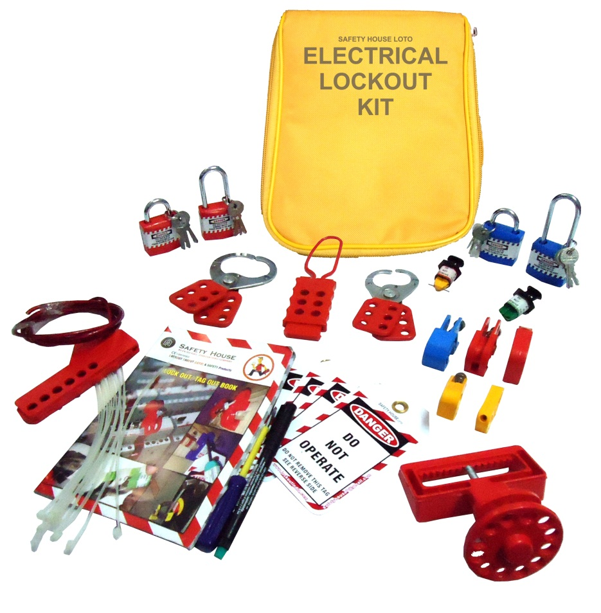
Safety EXPERTS
A UNIT OF SHIVA INDUSTRIAL CORPROTION
Item code - US-Yellow-Bag-Kit-3 – Rs.2,100/-
Lockout Bag - Yellow - 1 pc
Lockout Tag – 10 pcs
Lockout Guide Book – 1 pc
Dielectric Padlock long and regular shackle – 4 pcs.
Vinyl coated Hasp – Small – 1 pc
Vinyl coated Hasp – Premier – 1 pc
Dielectric Hasp with 6 holes – 1 pc
Scissor Cable Lockout– 1 pc
Pin Type MCB Lockout – 2 pcs
MCB Lockout different models – 5 pcs.
MCCB Lockout – 1 pc
Writing Pen – 1 pc
Screw Driver – 1 pc
Add: 4615-15, GROUND FLOOR, GALI SHAHTARA,, AJMERI GATE, DELHI-110006
E-mail : rahulsakhuja@yahoo.com TEL . : 011-23215050, Mob. No.9811048483

Slide 15
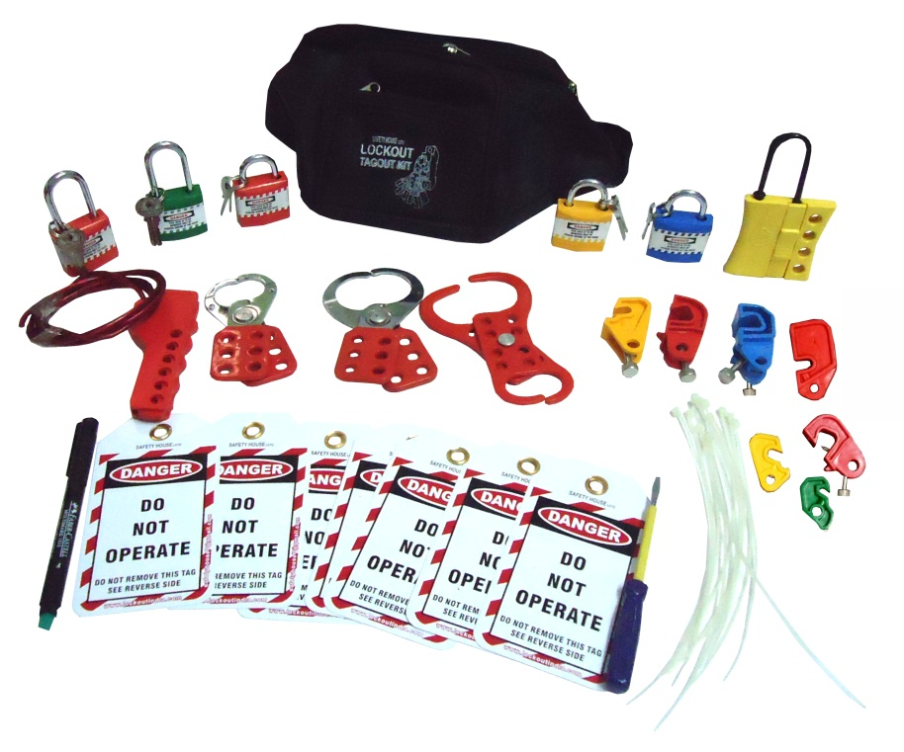
Safety EXPERTS
A UNIT OF SHIVA INDUSTRIAL CORPROTION
Item code - US-Black-WP-Kit-1 – Rs.2,100/-
Lockout Waist Pouch - Black- 1 pc
Lockout Tag – 10 pcs
Lockout Guide Book – 1 pc
Dielectric Padlock long and regular shackle – 5 pcs.
Vinyl coated Hasp – Small – 1 pc
Vinyl coated Hasp – Premier – 1 pc
Double Jaw Hasp – 1 pc
Scissor Cable Lockout– 1 pc
MCB Lockout different models – 7 pcs.
Slider Hasp – 1 pc
Writing Pen – 1 pc
Screw Driver – 1 pc
Add: 4615-15, GROUND FLOOR, GALI SHAHTARA,, AJMERI GATE, DELHI-110006
E-mail : rahulsakhuja@yahoo.com TEL . : 011-23215050, Mob. No.9811048483

Slide 16
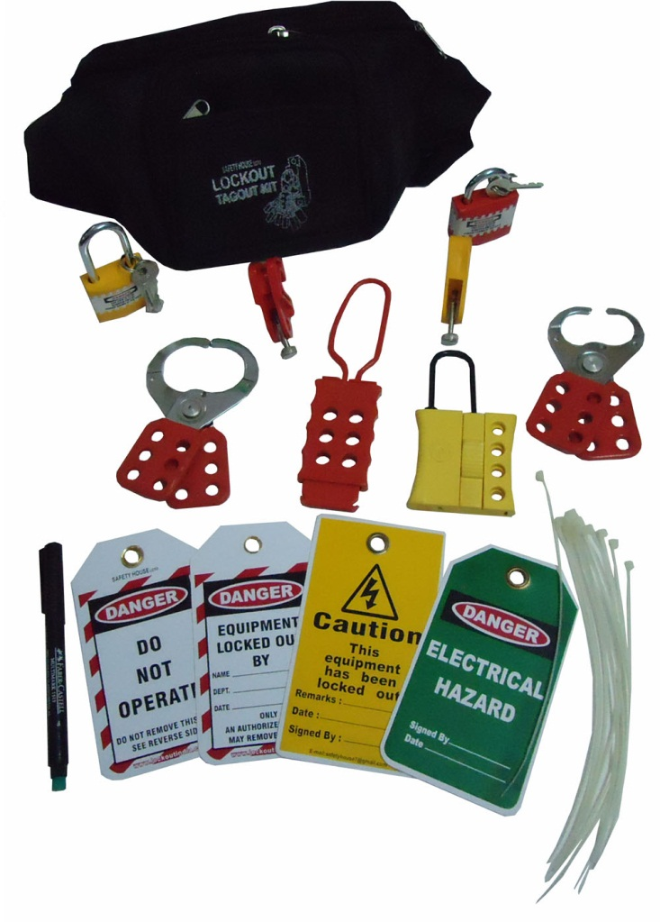
Safety EXPERTS
A UNIT OF SHIVA INDUSTRIAL CORPROTION
Item code - US-Black-WP-Kit-2- Rs. 1,200/-
Lockout Waist Pouch - Black- 1 pc
Lockout Tag – 5 pcs
Dielectric Padlock long and regular shackle – 3 pcs.
Vinyl coated Hasp – Small – 1 pc
Vinyl coated Hasp – Premier – 1 pc
Dielectric Hasp with 6 holes – 1 pc
MCB Lockout different models – 2 pcs.
Slider Hasp – 1 pc
Writing Pen – 1 pc
Lockout Ties – 5 pcs
Add: 4615-15, GROUND FLOOR, GALI SHAHTARA,, AJMERI GATE, DELHI-110006
E-mail : rahulsakhuja@yahoo.com TEL . : 011-23215050, Mob. No.9811048483

Slide 17
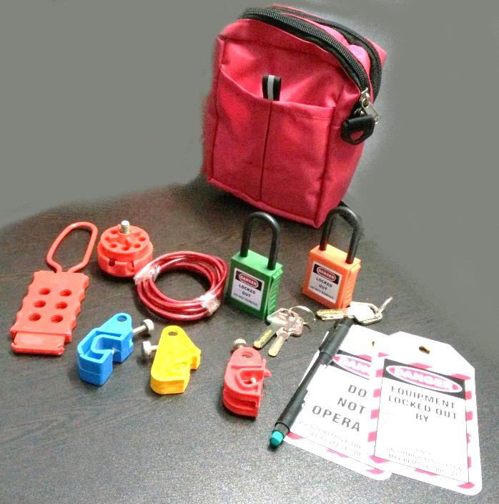
Safety EXPERTS
A UNIT OF SHIVA INDUSTRIAL CORPROTION
Item code - US-Red Pouch Kit – Rs.1,900/-
Lockout Waist Pouch - Red - 1 pc
Lockout Tag – 2 pcs
Dielectric OSHA Padlock – 2 pcs.
Dielectric Hasp with 6 holes – 1 pc
MCB Lockout different models – 3 pcs.
Round Cable Lockout – 1 pc
Writing marker pen - 1
Add: 4615-15, GROUND FLOOR, GALI SHAHTARA,, AJMERI GATE, DELHI-110006
E-mail : rahulsakhuja@yahoo.com TEL . : 011-23215050, Mob. No.9811048483

Slide 18
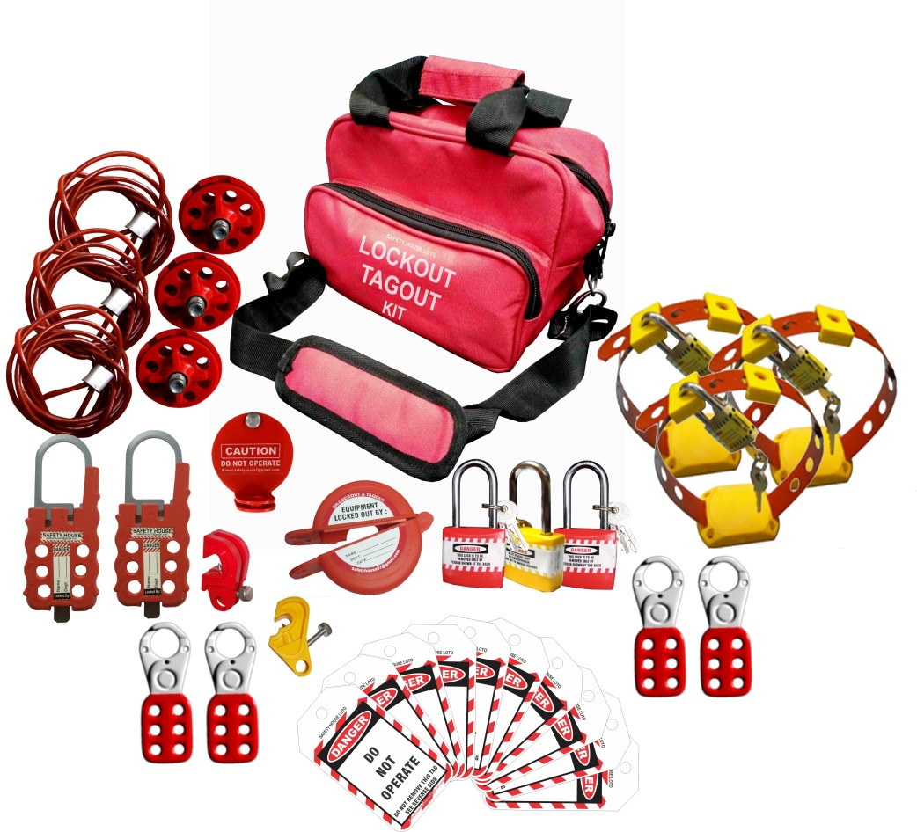
Safety EXPERTS
A UNIT OF SHIVA INDUSTRIAL CORPROTION
Item code - US-ELEC-CABLE-KIT – Rs.3,350/-
Lockout Red Bag – 1 pc
Padlock long shackle yellow red color – 3 Pc
Lockout Small hasp – 4 pc
MUCB Yellow lockout – 1 pc
Handle Lockout – 3 pc
Lockout push button – 1 pc
Lockout Tag – 10 pc
Round cable lockout – 3 pc
Big Multipurpose Cable lockout – 2 pc
Rack cover lockout – 1 pc
Add: 4615-15, GROUND FLOOR, GALI SHAHTARA,, AJMERI GATE, DELHI-110006
E-mail : rahulsakhuja@yahoo.com TEL . : 011-23215050, Mob. No.9811048483

Slide 19
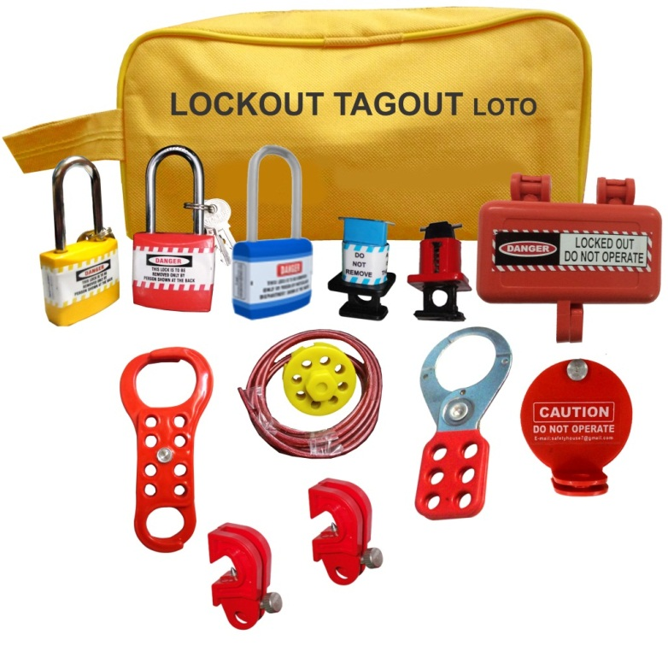
Safety EXPERTS
A UNIT OF SHIVA INDUSTRIAL CORPROTION
Item code – Yellow Electrical Kit Small – 1 – Rs.1,550/-
Lockout Yellow Pouch – 1 pc
Padlock long shackle diffrent color – 3 Pc
Lockout hasp big - 1 Pc
Plug lockout small – 1 pc
Lockout Rackout Cover – 1 pc
Round cable lockout – 1 pc
Lockout Pin different model – 2 pc
Universal Circuit Breaker Lockout – 2 pc
Di-Electric 6 hole hasp – 1 pc
Add: 4615-15, GROUND FLOOR, GALI SHAHTARA,, AJMERI GATE, DELHI-110006
E-mail : rahulsakhuja@yahoo.com TEL . : 011-23215050, Mob. No.9811048483

Slide 20
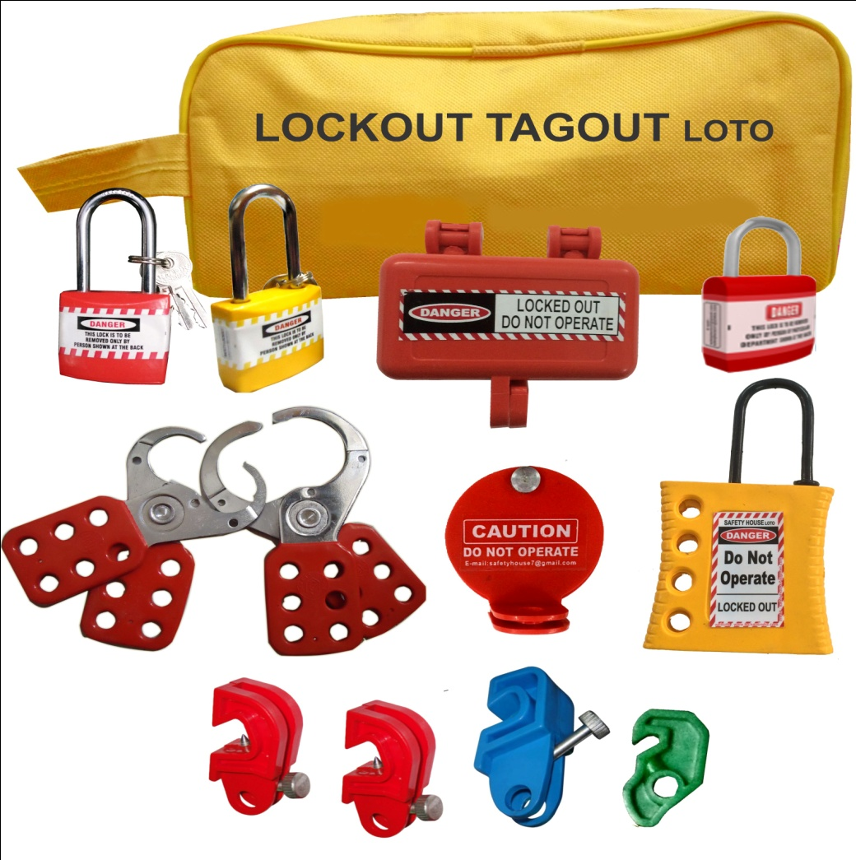
Safety EXPERTS
A UNIT OF SHIVA INDUSTRIAL CORPROTION
Item code – Yellow Electrical Kit Small – 2 – Rs. 1,400/-
Lockout Yellow Pouch – 1 pc
Padlock long shackle diffrent color – 2 Pc
Padlock Regular shackle re color – 1 pc
Lockout hasp small- 1 pc
Lockout hasp big - 1 Pc
Plug lockout small – 1 pc
Lockout Rackout Cover – 1 pc
Dielectric Yellow Hasp – 1 pc
UCB lockout different model – 4 pc
Add: 4615-15, GROUND FLOOR, GALI SHAHTARA,, AJMERI GATE, DELHI-110006
E-mail : rahulsakhuja@yahoo.com TEL . : 011-23215050, Mob. No.9811048483

Slide 21
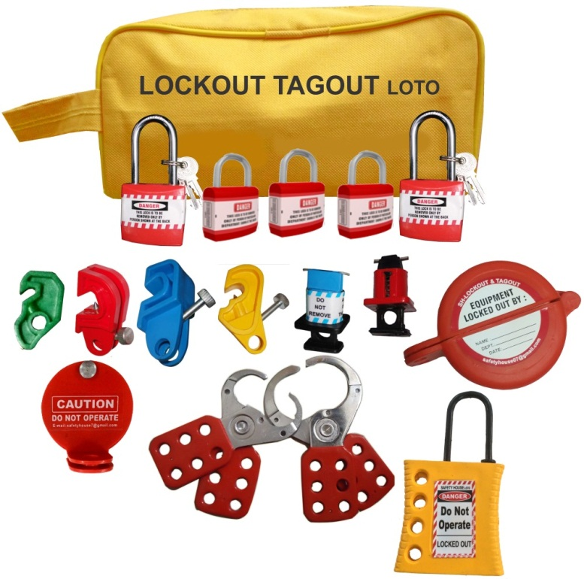
Safety EXPERTS
A UNIT OF SHIVA INDUSTRIAL CORPROTION
Item code – Yellow Electrical Kit Small – 3 – Rs.1,700/-
Lockout Yellow Pouch – 1 pc
Padlock long shackle red color – 2 Pc
Padlock regular shackle red color – 3pc
Lockout hasp small- 1 pc
Lockout hasp big - 1 Pc
Lockout Push Button – 1 pc
Lockout Rackout Cover – 1 pc
Lockout Pin different model – 2 pc
Universal Circuit Breaker Lockout – 4 pc
Dielectric Yellow Hasp – 1 pc
Add: 4615-15, GROUND FLOOR, GALI SHAHTARA,, AJMERI GATE, DELHI-110006
E-mail : rahulsakhuja@yahoo.com TEL . : 011-23215050, Mob. No.9811048483

Slide 22
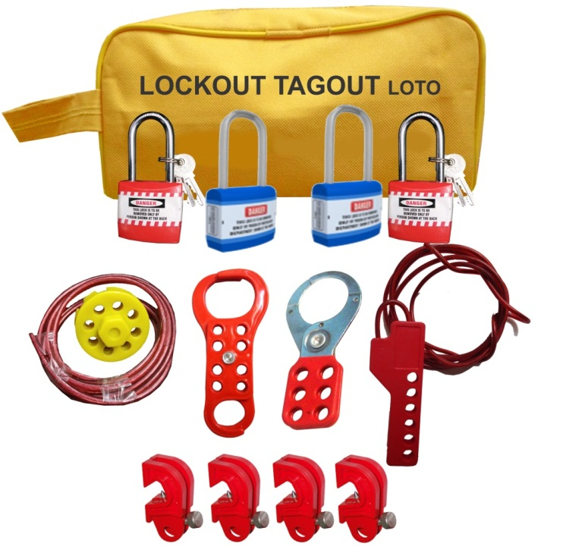
Safety EXPERTS
A UNIT OF SHIVA INDUSTRIAL CORPROTION
Item code – Yellow Electrical Kit Small – 4- Rs.1,500/-
Lockout Yellow Pouch – 1 pc
Padlock long shackle different color – 4 Pc
Lockout hasp big - 1 Pc
Universal Circuit Breaker Lockout – 4 pc
Scissor cable Lockout – 1 pc
Lockout Dual Scissor 6 Hasp – 1 Pc
Round cable lockout – 1 pc
Add: 4615-15, GROUND FLOOR, GALI SHAHTARA,, AJMERI GATE, DELHI-110006
E-mail : rahulsakhuja@yahoo.com TEL . : 011-23215050, Mob. No.9811048483

Slide 23
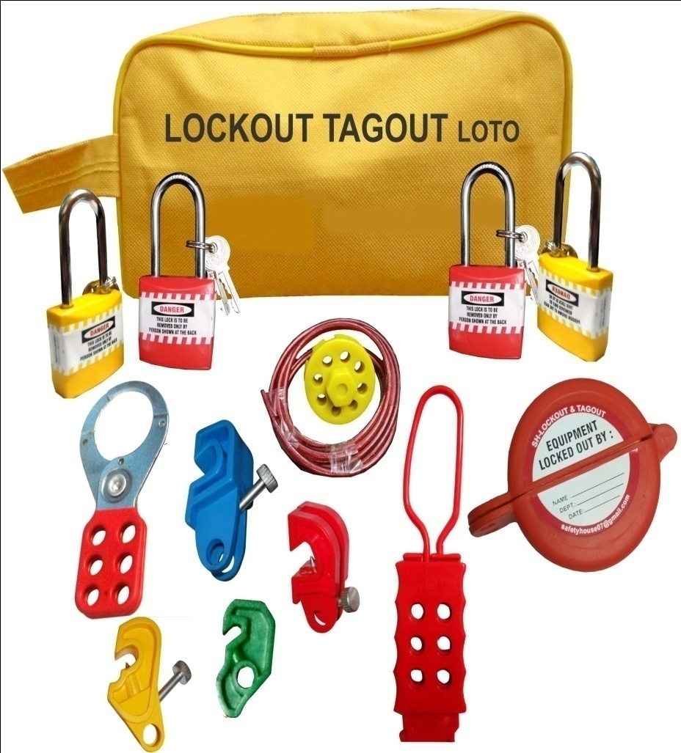
Safety EXPERTS
A UNIT OF SHIVA INDUSTRIAL CORPROTION
Item code – Yellow Electrical Kit Small - 5
Lockout Yellow Pouch – 1 pc
Padlock long shackle diffrent color – 4 Pc
UCB different model – 4 pc
Dielectric 6 hole hasp – 1 pc
Round cable lockout – 1 pc
Lockout push button – 1 pc
Lockout Hasp Big – 1 pc
Add: 4615-15, GROUND FLOOR, GALI SHAHTARA,, AJMERI GATE, DELHI-110006
E-mail : rahulsakhuja@yahoo.com TEL . : 011-23215050, Mob. No.9811048483

Slide 24
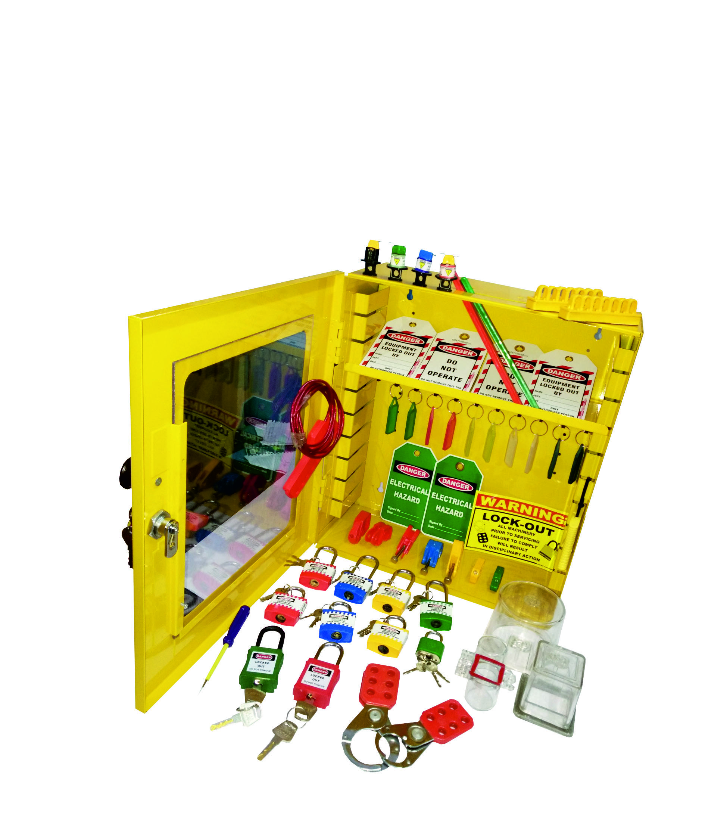
Safety EXPERTS
A UNIT OF SHIVA INDUSTRIAL CORPROTION
Item code – US-STATION-ELEC-KIT-2 – Rs.6,200/-
Lockout station 6inch - 1 Pc
MCB Lockout different model - 7 pc
Lockout padlock Long shackle – 4 pc
Lockout padlock Regular shackle –4 pc
Dielectric padlock – 2 Pc
Lockout hasp small – 1 pc
Lockout hasp big – 1 pc
Lockout tag – 10 – pc
Lockout green tag – 2 Pc
Scissor cable lockout – 1 Pc
Screw driver – 1 Pc
Lockout Sign – 1 Pc
Lockout Pin different color – 3 Pc
Breaker lockout kit – 1Pc
Electrical Panel Lockout transprent different modal – 3 Pc
Lockout Keyring different color – 10 Pc
Add: 4615-15, GROUND FLOOR, GALI SHAHTARA,, AJMERI GATE, DELHI-110006
E-mail : rahulsakhuja@yahoo.com TEL . : 011-23215050, Mob. No.9811048483

Slide 25
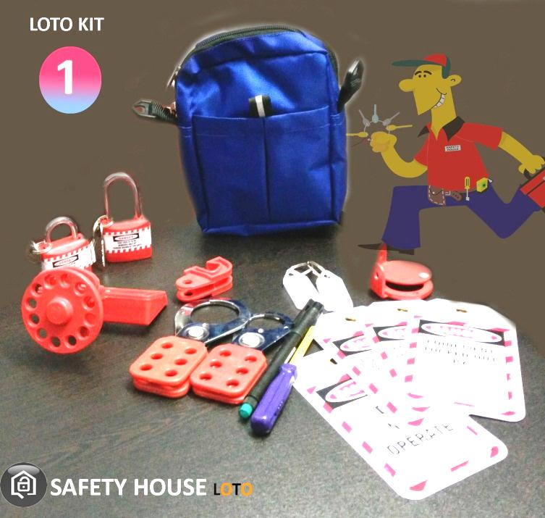
Safety EXPERTS
A UNIT OF SHIVA INDUSTRIAL CORPROTION
Item code - US-Blue Pouch kit – Rs.1250/-
Lockout Waist Pouch - Blue - 1 pc
Lockout Tag – 5 pcs
Rack In Out device – 1 pc
MCCB Lockout – 1 pc
Lockout Padlock – Long and regular – 2 pcs.
Lockout Hasp – Small – 1 pc
Lockout Hasp – Premier – 1 pc
MCB Lockout– 1 pc
Writing marker pen – 1
Screw Driver – 1 pc
Keyrings – 2 pcs
Add: 4615-15, GROUND FLOOR, GALI SHAHTARA,, AJMERI GATE, DELHI-110006
E-mail : rahulsakhuja@yahoo.com TEL . : 011-23215050, Mob. No.9811048483

Slide 26
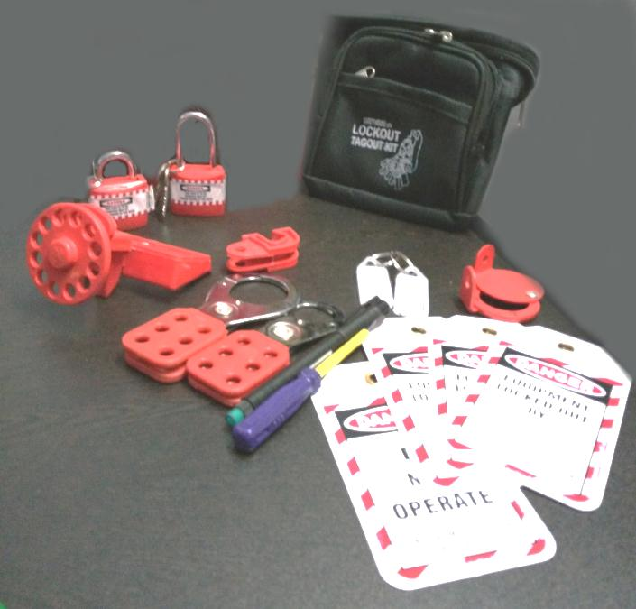
Safety EXPERTS
A UNIT OF SHIVA INDUSTRIAL CORPROTION
Item code - US-Black Waist pouch kit – Rs.1,200/-
Lockout Waist Pouch - Black - 1 pc
Lockout Tag – 5 pcs
Rack In Out device – 1 pc
MCCB Lockout – 1 pc
Lockout Padlock – Long and regular – 2 pcs.
Lockout Hasp – Small – 1 pc
Lockout Hasp – Premier – 1 pc
MCB Lockout– 1 pc
Writing marker pen – 1
Screw Driver – 1 pc
Keyrings – 2 pcs
Add: 4615-15, GROUND FLOOR, GALI SHAHTARA,, AJMERI GATE, DELHI-110006
E-mail : rahulsakhuja@yahoo.com TEL . : 011-23215050, Mob. No.9811048483

Slide 27
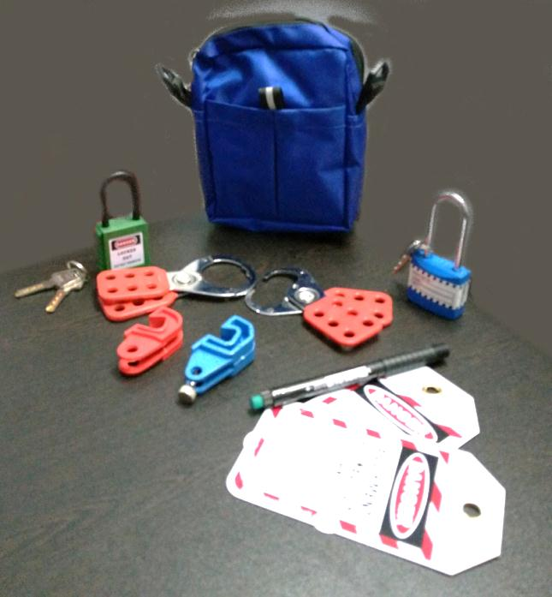
Safety EXPERTS
A UNIT OF SHIVA INDUSTRIAL CORPROTION
Item code - US-Blue Waist pouch kit – Rs.1,300/-
Lockout Waist Pouch - Blue - 1 pc
Lockout Tag – 2 pcs
Lockout Padlock – Long shackle – 1 pc
OSHA Padlock – 1 pc
Lockout Hasp – Small – 1 pc
Lockout Hasp – Premier – 1 pc
MCB Lockout– 2 pcs
Writing marker pen – 1 pc
Add: 4615-15, GROUND FLOOR, GALI SHAHTARA,, AJMERI GATE, DELHI-110006
E-mail : rahulsakhuja@yahoo.com TEL . : 011-23215050, Mob. No.9811048483

Slide 28
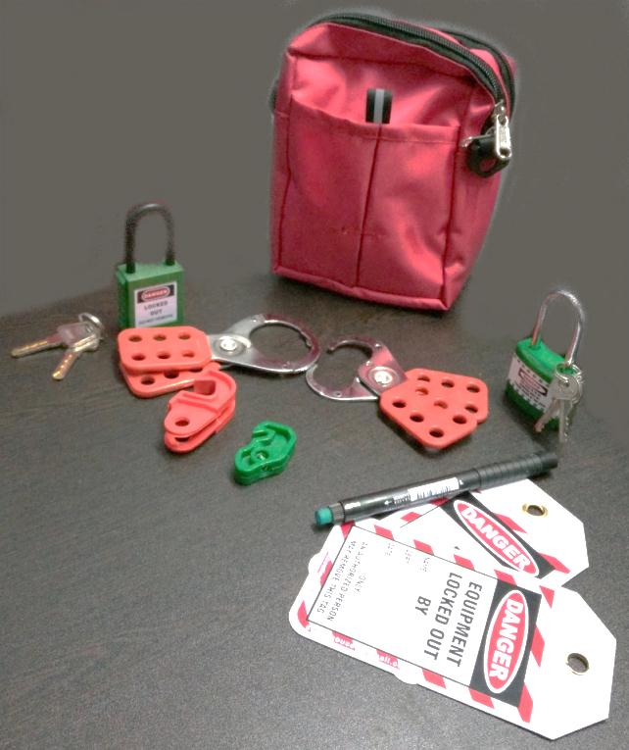
Safety EXPERTS
A UNIT OF SHIVA INDUSTRIAL CORPROTION
Item code - US-Red Waist pouch kit– Rs.1,300-
Lockout Waist Pouch - Red - 1 pc
Lockout Tag – 2 pcs
Lockout Padlock – Long shackle – 1 pc
OSHA Padlock – 1 pc
Lockout Hasp – Small – 1 pc
Lockout Hasp – Premier – 1 pc
MCB Lockout– 2 pcs
Writing marker pen – 1 pc
Add: 4615-15, GROUND FLOOR, GALI SHAHTARA,, AJMERI GATE, DELHI-110006
E-mail : rahulsakhuja@yahoo.com TEL . : 011-23215050, Mob. No.9811048483

Slide 29
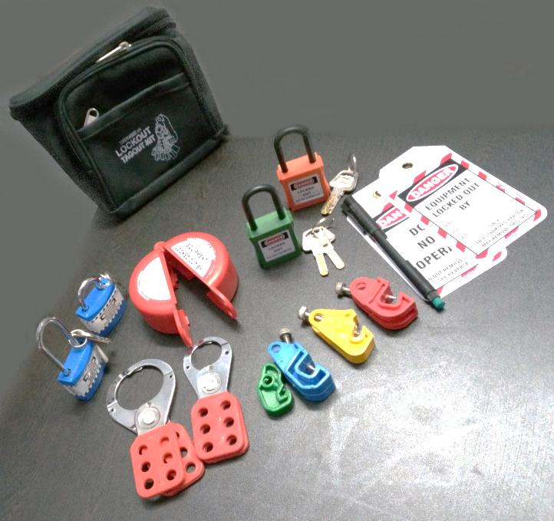
Safety EXPERTS
A UNIT OF SHIVA INDUSTRIAL CORPROTION
Item code - US-Black Waist pouch kit- Rs.2,100/-
Lockout Waist Pouch - Black - 1 pc
Lockout Tag – 2 pcs
Lockout Padlock – Long and regular shackle – 2 pcs
OSHA Padlock – 2 pcs
Lockout Hasp – Small – 1 pc
Lockout Hasp – Premier – 1 pc
MCB Lockout– 4 pcs
Push button lockout – 1 pc
Writing marker pen – 1 pc
Add: 4615-15, GROUND FLOOR, GALI SHAHTARA,, AJMERI GATE, DELHI-110006
E-mail : rahulsakhuja@yahoo.com TEL . : 011-23215050, Mob. No.9811048483

Slide 30

Safety EXPERTS
A UNIT OF SHIVA INDUSTRIAL CORPROTION
Item code - US-Red Waist pouch kit – Rs.1,600/-
Lockout Waist Pouch - Red - 1 pc
Lockout Tag – 2 pcs
Dielectric Hasp – 1 pc
Round cable lockout – 1 pc
OSHA Padlock – 2 pcs
MCB Lockout– 3 pcs
Push button lockout – 1 pc
Writing marker pen – 1 pc
Add: 4615-15, GROUND FLOOR, GALI SHAHTARA,, AJMERI GATE, DELHI-110006
E-mail : rahulsakhuja@yahoo.com TEL . : 011-23215050, Mob. No.9811048483

Slide 31
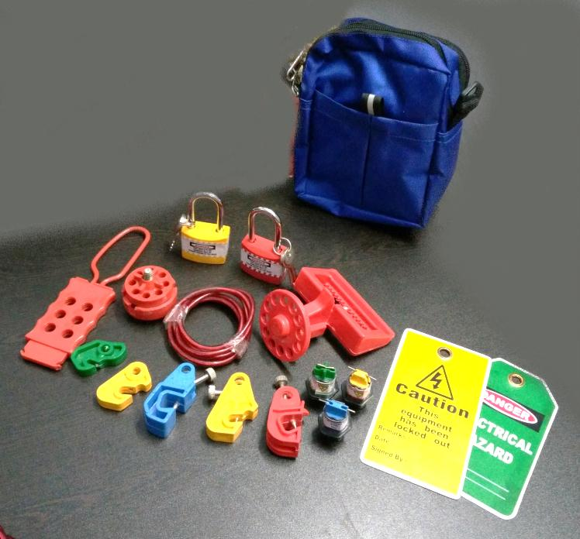
Safety EXPERTS
A UNIT OF SHIVA INDUSTRIAL CORPROTION
Item code - US-Blue Waist pouch kit- Rs.1,600/-
Lockout Waist Pouch - Blue - 1 pc
Lockout Tag – 2 pcs
Dielectric Hasp – 1 pc
Round cable lockout – 1 pc
MCCB Lockout – 1 pc
Lockout Padlock – Long shackle – 2 pcs
MCB Lockout– 5 pcs
Pin Type MCB Lockout – 3 pcs
Add: 4615-15, GROUND FLOOR, GALI SHAHTARA,, AJMERI GATE, DELHI-110006
E-mail : rahulsakhuja@yahoo.com TEL . : 011-23215050, Mob. No.9811048483

Slide 32
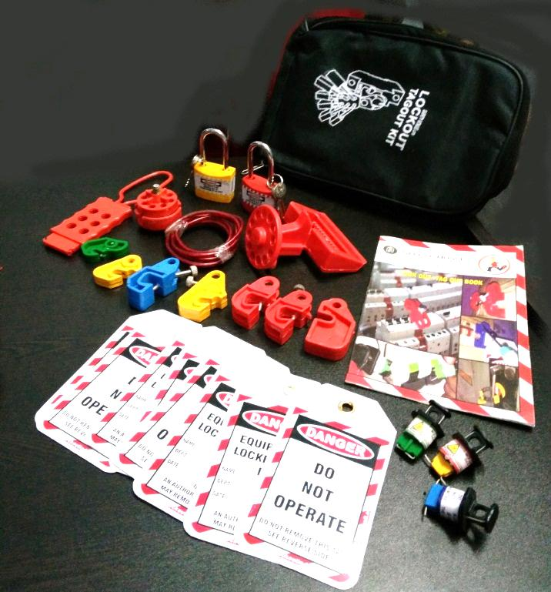
Safety EXPERTS
A UNIT OF SHIVA INDUSTRIAL CORPROTION
Item code – US-Black pouch kit-Rs.1,900/-
Lockout Pouch - Black - 1 pc
Lockout Tag – 5 pcs
Dielectric Hasp – 1 pc
Round cable lockout – 1 pc
MCCB Lockout – 1 pc
Lockout Padlock – Long shackle – 2 pcs
MCB Lockout– 7 pcs
Pin Type MCB Lockout – 3 pcs
Lockout Book – 1 pc
Add: 4615-15, GROUND FLOOR, GALI SHAHTARA,, AJMERI GATE, DELHI-110006
E-mail : rahulsakhuja@yahoo.com TEL . : 011-23215050, Mob. No.9811048483

Slide 33
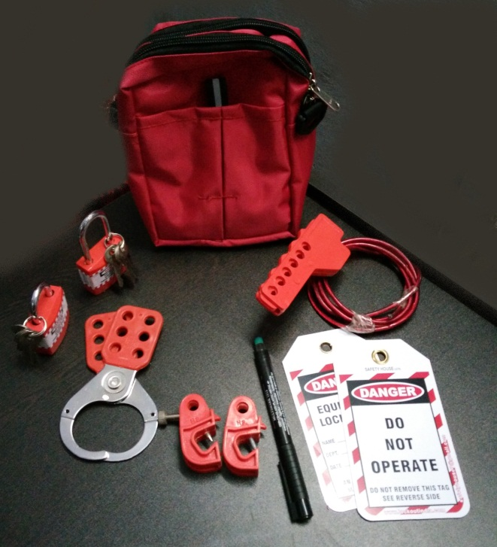
Safety EXPERTS
A UNIT OF SHIVA INDUSTRIAL CORPROTION
Item code – US-Red pouch kit-Rs.1000/-
Lockout Pouch - Red - 1 pc
Lockout Tag – 2 pcs
Vinyl coated Hasp – premier – 1 pc
Scissor type cable lockout – 1 pc
Lockout Padlock – Long shackle – 2 pcs
MCB Lockout– 2 pcs
Writing pen – 1 pc
Add: 4615-15, GROUND FLOOR, GALI SHAHTARA,, AJMERI GATE, DELHI-110006
E-mail : rahulsakhuja@yahoo.com TEL . : 011-23215050, Mob. No.9811048483

Slide 34
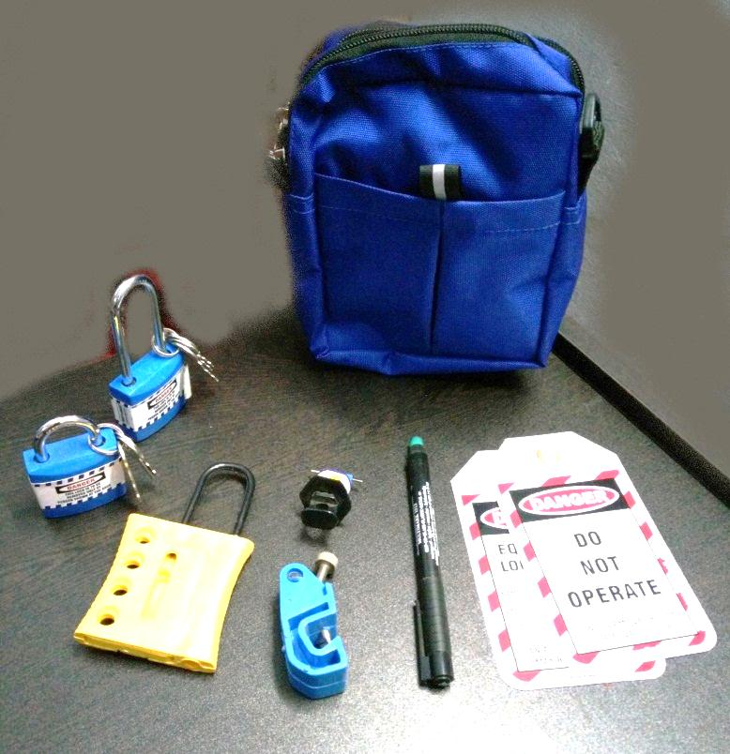
Safety EXPERTS
A UNIT OF SHIVA INDUSTRIAL CORPROTION
Item code – US-Blue pouch kit-Rs.1000/-
Lockout Pouch – Blue - 1 pc
Lockout Tag – 2 pcs
Dielectric Hasp – Yellow – 1 pc
Pin Type MCB Lockout – 1 pc
Lockout Padlock – Long and regular shackle – 2 pcs
MCB Lockout– 1 pc
Writing pen – 1 pc
Add: 4615-15, GROUND FLOOR, GALI SHAHTARA,, AJMERI GATE, DELHI-110006
E-mail : rahulsakhuja@yahoo.com TEL . : 011-23215050, Mob. No.9811048483

Slide 35
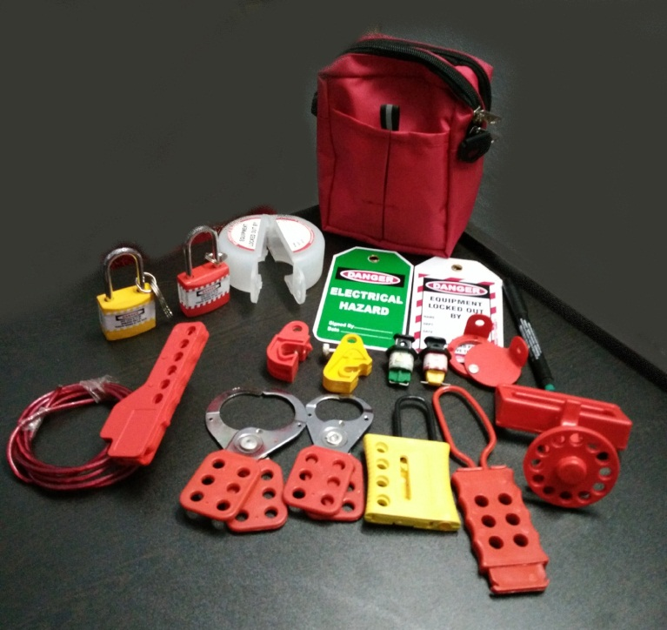
Safety EXPERTS
A UNIT OF SHIVA INDUSTRIAL CORPROTION
Item code – US-Red pouch kit-Rs.1,900/-
Lockout Pouch – Red - 1 pc
Lockout Tag – 2 pcs
Dielectric Hasp – Yellow – 1 pc
Dielectric Hasp with 6 holes – 1 pc
Vinyl coated Hasp – Small – 1 pc
Vinyl coated Hasp – Premier – 1 pc
Push button Lockout – 1 pc
Pin Type MCB Lockout – 2 pcs
Lockout Padlock – Long and regular shackle – 2 pcs
Scissor Type cable Lockout – 1 pc
MCB Lockout– 2 pcs
MCCB Lockout – 1 pc
Rack In Out Device – 1 pc
Writing pen – 1 pc
Add: 4615-15, GROUND FLOOR, GALI SHAHTARA,, AJMERI GATE, DELHI-110006
E-mail : rahulsakhuja@yahoo.com TEL . : 011-23215050, Mob. No.9811048483

Slide 36
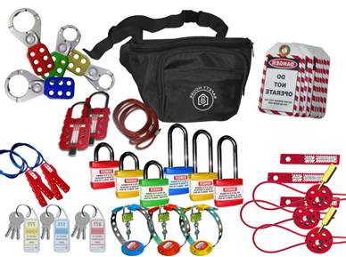
Safety EXPERTS
A UNIT OF SHIVA INDUSTRIAL CORPROTION
Item code - US-EWP-KIT – Rs.3,400/-
Lockout Waist Pouch - 1 pc
Lockout Hasp – Small – 2 pcs
Lockout Hasp – Premier – 2 pcs
Lockout Tag – 10 pcs
Handle Lockout – 3 pcs
Padlock – Longs shackle – 3 pcs
Padlock – Regular shackle – 3 pcs
Keyrings – 3 pcs
Round Cable Lockout – 2 pcs
Big Multipurpose Cable Lockout – 2 pcs
Scissor Type Cable Lockout – 2 pcs
Handle Lockout – 3 pcs
Add: 4615-15, GROUND FLOOR, GALI SHAHTARA,, AJMERI GATE, DELHI-110006
E-mail : rahulsakhuja@yahoo.com TEL . : 011-23215050, Mob. No.9811048483

Slide 37
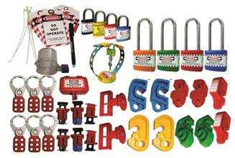
Safety EXPERTS
A UNIT OF SHIVA INDUSTRIAL CORPROTION
Item code - US-MCB-L-KIT –Rs.3,700/-
Lockout Hasp – Small – 3 pcs
Lockout Hasp – Premier – 3 pcs
Lockout Tag – 10 pcs
Writing Marker pen – 1 pc
Lockout Ties – 10 pcs
Lockout Padlock – Long shackle – 4 pcs
Lockout padlock – Regular shackle – 4 pcs
MCB Lockout – different models – 10 pcs
Pin Type MCB Lockout – 3 pcs
MCCB / LCB Lockout – 2 pcs
Plug Lockout – Small – 1 pc
Electrical Panel Lockout - Small – Round – 1 pc
Handle Lockout – 1 pc
Writing Marker Pen – 1 pc
Add: 4615-15, GROUND FLOOR, GALI SHAHTARA,, AJMERI GATE, DELHI-110006
E-mail : rahulsakhuja@yahoo.com TEL . : 011-23215050, Mob. No.9811048483

Slide 38
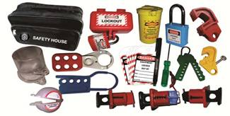
Safety EXPERTS
A UNIT OF SHIVA INDUSTRIAL CORPROTION
Item code - US-PLUG-L-KIT – Rs.2,400/-
Lockout Bag- 1 pc
Lockout Hasp – Small – 1 pc
Dielectric Hasp – 1 pc
Lockout Tag – 2 pcs
Plug Lockout – Small – 1 pc
Cylinder Lockout – 1 pc
MCB Lockout – Different models – 2 pcs
Pin Type MCB Lockout – 3 pcs
Dielectric padlock – 1 pc
Push button Lockout – 1 pc
Electrical Panel Lockout – 1 pc
Scissor Type Cable Lockout – 1 pc
Writing Marker pen – 1 pc
Screw Driver – 1 pc
Add: 4615-15, GROUND FLOOR, GALI SHAHTARA,, AJMERI GATE, DELHI-110006
E-mail : rahulsakhuja@yahoo.com TEL . : 011-23215050, Mob. No.9811048483

Slide 39

Safety EXPERTS
A UNIT OF SHIVA INDUSTRIAL CORPROTION
Item code - US-ELEC-LOTO-KIT-Rs.3,800/-
Lockout Bag- 1 pc
Lockout Hasp – Small – 1 pc
Lockout Hasp – Premier – 1 pc
Lockout Tag – 10 pcs
Handle Lockout – 1 pc
Plug Lockout – Small – 1 pc
Cylinder Lockout – 1 pc
MCB Lockout – Different models – 5 pcs
Pin Type MCB Lockout – 3 pcs
Padlock – Longs shackle – 3 pcs
Padlock – Regular shackle – 3 pcs
Keyrings – 3 pcs
Round Cable Lockout – 1 pc
Big Multipurpose Cable Lockout – 1 pc
Scissor Type Cable Lockout – 1 pc
Add: 4615-15, GROUND FLOOR, GALI SHAHTARA,, AJMERI GATE, DELHI-110006
E-mail : rahulsakhuja@yahoo.com TEL . : 011-23215050, Mob. No.9811048483

Slide 40
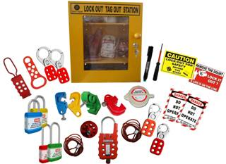
Safety EXPERTS
A UNIT OF SHIVA INDUSTRIAL CORPROTION
Item code - US-LT-STATION-KIT-Rs.4,450/-
Lockout Station- 1 pc
Lockout Hasp – Small – 2 pcs
Lockout Hasp – Premier – 2 pcs
Dielectric Hasp – 1 pc
Double Jaw Hasp – 1 pc
MCB Lockout – different Models – 4 pcs
Writing Marker pen – 1 pc
Lockout Tag – 5 pcs
Padlock – Longs shackle – 2 pcs
Padlock – Regular shackle – 2 pcs
Lockout Labels – 2 pcs
Round Cable Lockout – 1 pc
Big Multipurpose Cable Lockout – 1 pc
Push Button Lockout – 1 pc
Screw Driver – 1 pc
Add: 4615-15, GROUND FLOOR, GALI SHAHTARA,, AJMERI GATE, DELHI-110006
E-mail : rahulsakhuja@yahoo.com TEL . : 011-23215050, Mob. No.9811048483

Slide 41
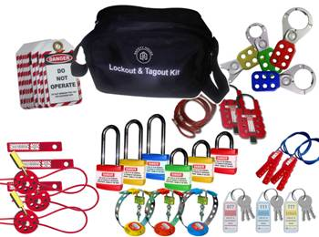
Safety EXPERTS
A UNIT OF SHIVA INDUSTRIAL CORPROTION
Item code - US-ELEC-LOTO-KIT – Rs.3,650/-
Lockout Bag- 1 pc
Lockout Hasp – Small – 2 pcs
Lockout Hasp – Premier – 2 pcs
Lockout Tag – 10 pcs
Padlock – Longs shackle – 3 pcs
Padlock – Regular shackle – 3 pcs
Keyrings – 6 pcs
Round Cable Lockout – 3 pcs
Big Multipurpose Cable Lockout – 2 pcs
Scissor Type Cable Lockout – 2 pcs
Handle Lockout – 3 pcs.
Add: 4615-15, GROUND FLOOR, GALI SHAHTARA,, AJMERI GATE, DELHI-110006
E-mail : rahulsakhuja@yahoo.com TEL . : 011-23215050, Mob. No.9811048483

Slide 42
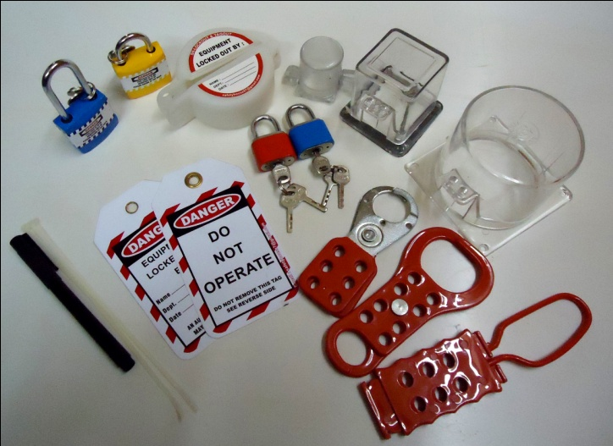
Safety EXPERTS
A UNIT OF SHIVA INDUSTRIAL CORPROTION
Item code - US-PB-LOTO-KIT – Rs. 1050/-
Lockout Hasp – Small – 1 pc
Dielectric Hasp – 1 pc
Double Jaw Hasp – 1 pc
Lockout Tag – 2 pcs
Push Button Lockout – 1 pc
Padlock – Long shackle – 1 pc
Padlock – regular shackle – 1 pc
Small Locks – 2 pcs
Electrical Panel Lockout – small – Round – 1 pc
Electrical Panel Lockout – Small – Square – 1 pc
Electrical Panel lockout – Large – Square – 1 pc
Writing Marker pen – 1 pc
Add: 4615-15, GROUND FLOOR, GALI SHAHTARA,, AJMERI GATE, DELHI-110006
E-mail : rahulsakhuja@yahoo.com TEL . : 011-23215050, Mob. No.9811048483

Slide 43
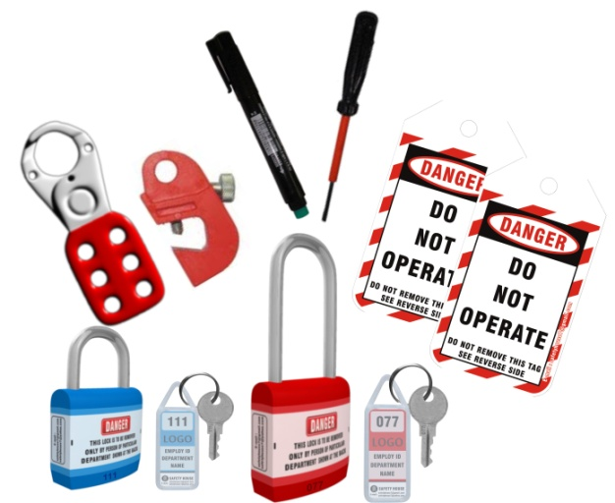
Safety EXPERTS
A UNIT OF SHIVA INDUSTRIAL CORPROTION
Item code - US-ESSN-LOTO-KIT – 575/-
Transparent Pouch – 1 pc
MCB Lockout – 1 pc
Lockout Hasp – Small – 1 pc
Lockout Tag – 2 pcs
Padlock – Long shackle – 1 pc
Padlock – regular shackle – 1 pc
Keyrings – 2 pcs
Screw Driver – 1 pc
Writing Marker pen – 1 pc
Add: 4615-15, GROUND FLOOR, GALI SHAHTARA,, AJMERI GATE, DELHI-110006
E-mail : rahulsakhuja@yahoo.com TEL . : 011-23215050, Mob. No.9811048483

Slide 44
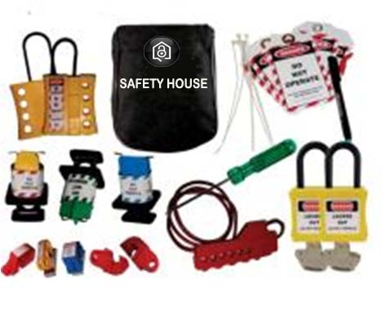
Safety EXPERTS
A UNIT OF SHIVA INDUSTRIAL CORPROTION
Item code - US-MCB-SMALL-KIT – Rs.1610/-
Lockout Pouch – 1 pc
MCB Lockout – different Models – 5 pcs
PIN Type MCB Lockout – 3 pcs
Scissor type Cable Lockout – 1 pc
Lockout Tag – 5 pcs
Lockout Ties – 5 pcs
Dielectric Yellow Hasp – 2 pcs
Dielectric Padlock – 2 pcs
Screw Driver – 1 pc
Writing Marker pen – 1 pc
Add: 4615-15, GROUND FLOOR, GALI SHAHTARA,, AJMERI GATE, DELHI-110006
E-mail : rahulsakhuja@yahoo.com TEL . : 011-23215050, Mob. No.9811048483

Slide 45
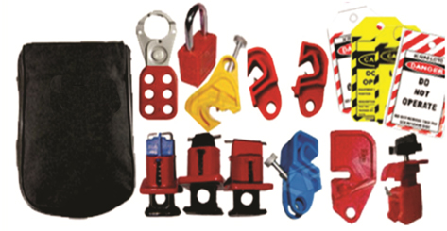
Safety EXPERTS
A UNIT OF SHIVA INDUSTRIAL CORPROTION
Item code - US-MCB-POUCH-KIT – Rs.1150/-
Lockout Pouch – 1 pc
MCB Lockout – different Models – 5 pcs
PIN Type MCB Lockout – 3 pcs
Tie Bar Lockout – 1 pc
Lockout Tag – 5 pcs
Lockout Ties – 5 pcs
Vinyl coated Hasp – 1 pc
Dielectric Padlock – 1 pc
Add: 4615-15, GROUND FLOOR, GALI SHAHTARA,, AJMERI GATE, DELHI-110006
E-mail : rahulsakhuja@yahoo.com TEL . : 011-23215050, Mob. No.9811048483

Slide 46
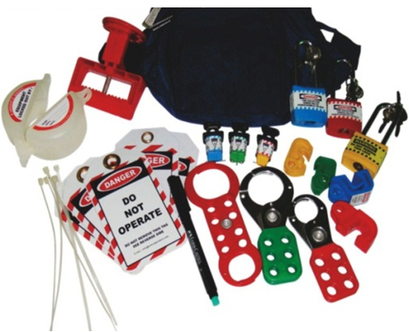
Safety EXPERTS
A UNIT OF SHIVA INDUSTRIAL CORPROTION
Item code - US-MCB-WPOUCH-KIT–Rs.1750/-
Lockout Waist Pouch – 1 pc
Double jaw Hasp – 1 pc
Push Button Lockout – Round – 1 pc
MCB Lockout – different Models – 4 pcs
PIN Type MCB Lockout – 3 pcs
MCCB Lockout – 1 pc
Lockout Tag – 5 pcs
Lockout Ties – 5 pcs
Vinyl coated Hasp – 2 pcs
Padlock – Long shackle – 3 pcs
Writing pen – 1 pc
Add: 4615-15, GROUND FLOOR, GALI SHAHTARA,, AJMERI GATE, DELHI-110006
E-mail : rahulsakhuja@yahoo.com TEL . : 011-23215050, Mob. No.9811048483

Slide 47
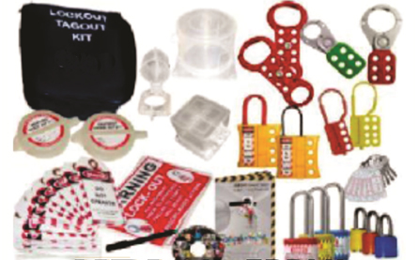
Safety EXPERTS
A UNIT OF SHIVA INDUSTRIAL CORPROTION
Item code - US-PB-MED-LOTO-KIT – Rs.2500/-
Lockout Pouch – 1 pc
Dielectric Hasp – Yellow – 2 pcs
Double jaw Hasp – 2 pcs
Dielectric Hasp 6 holes – 2 pcs
Push Button Lockout – Round – 2 pcs
Electrical Panel Lockout – Small Round – 1 pc
Electrical Panel Lockout – Small Square – 1 pc
Electrical Panel Lockout – Large – Round - 1 pc
Lockout Tag – 10 pcs
Lockout Ties – 10 pcs
Vinyl coated Hasp – 2 pcs
Padlock – Long shackle – 2 pcs
Small Locks – 3 pcs
Lockout Labels – 2 pcs
Lockout Book – 1 pc
LOTO CD presentation – 1 pc
Keyring – 1 pcs
Writing pen – 1 pc
Add: 4615-15, GROUND FLOOR, GALI SHAHTARA,, AJMERI GATE, DELHI-110006
E-mail : rahulsakhuja@yahoo.com TEL . : 011-23215050, Mob. No.9811048483

Slide 48

Safety EXPERTS
A UNIT OF SHIVA INDUSTRIAL CORPROTION
Item code - US-LOTO-BASIC-KIT –Rs.1550/-
Lockout Pouch – 1 pc
MCB Lockout – Different Models – 5 pcs
Pin Type MCB Lockout – 3 pcs.
MCCB Lockout – 1 pc
Dielectric Hasp – Yellow – 1 pc
Lockout Tag – 10 pcs
Lockout Ties – 10 pcs
Vinyl coated Hasp – 2 pcs
Padlock – Long shackle – 1 pc
Keyring – 1 pcs
Writing pen – 1 pc
Add: 4615-15, GROUND FLOOR, GALI SHAHTARA,, AJMERI GATE, DELHI-110006
E-mail : rahulsakhuja@yahoo.com TEL . : 011-23215050, Mob. No.9811048483

Slide 49
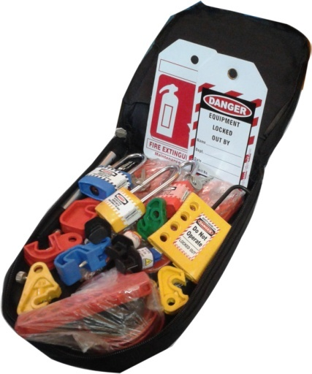
Safety EXPERTS
A UNIT OF SHIVA INDUSTRIAL CORPROTION
Item code - US-LOTO-BASIC-KIT –Rs.1550/-
Lockout Pouch – 1 pc
MCB Lockout – Different Models – 5 pcs
Pin Type MCB Lockout – 3 pcs.
MCCB Lockout – 1 pc
Dielectric Hasp – Yellow – 1 pc
Lockout Tag – 10 pcs
Lockout Ties – 10 pcs
Vinyl coated Hasp – 2 pcs
Padlock – Long shackle – 2 pcs
Keyring – 1 pcs
Writing pen – 1 pc
Add: 4615-15, GROUND FLOOR, GALI SHAHTARA,, AJMERI GATE, DELHI-110006
E-mail : rahulsakhuja@yahoo.com TEL . : 011-23215050, Mob. No.9811048483

Slide 50
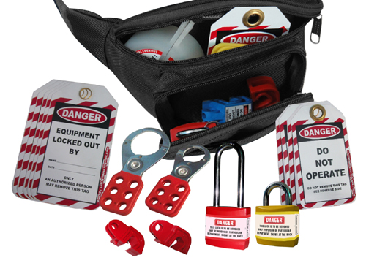
Safety EXPERTS
A UNIT OF SHIVA INDUSTRIAL CORPROTION
Item code - US-LOTO-WP-BASIC-KIT- Rs.1365/-
Lockout Waist Pouch – 1 pc
MCB Lockout – Different Models – 5 pcs
Dielectric Hasp – Yellow – 1 pc
Lockout Tag – 10 pcs
Lockout Ties – 10 pcs
Vinyl coated Hasp – 2 pcs
Push Button Lockout – 1 pc
Padlock – Long shackle – 1 pc
Padlock – Regular shackle – 1 pc
Keyring – 2 pcs
Writing pen – 1 pc
Add: 4615-15, GROUND FLOOR, GALI SHAHTARA,, AJMERI GATE, DELHI-110006
E-mail : rahulsakhuja@yahoo.com TEL . : 011-23215050, Mob. No.9811048483

Slide 51
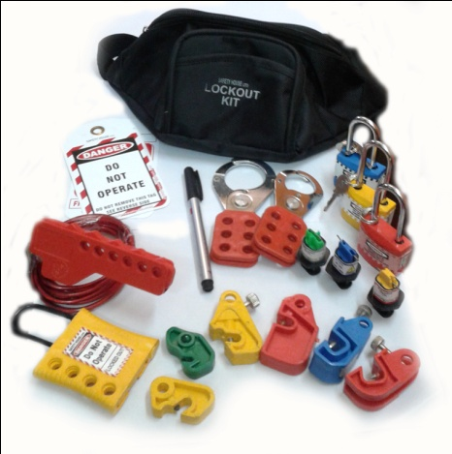
Safety EXPERTS
A UNIT OF SHIVA INDUSTRIAL CORPROTION
Item code - US-LOTO-WP-BASIC-KIT- Rs.1365/-
Lockout Waist Pouch – 1 pc
MCB Lockout – Different Models – 5 pcs
Dielectric Hasp – Yellow – 1 pc
Lockout Tag – 10 pcs
Lockout Ties – 10 pcs
Vinyl coated Hasp – 2 pcs
Push Button Lockout – 1 pc
Padlock – Long shackle – 1 pc
Padlock – Regular shackle – 1 pc
Keyring – 2 pcs
Writing pen – 1 pc
Add: 4615-15, GROUND FLOOR, GALI SHAHTARA,, AJMERI GATE, DELHI-110006
E-mail : rahulsakhuja@yahoo.com TEL . : 011-23215050, Mob. No.9811048483

Slide 52

Safety EXPERTS
A UNIT OF SHIVA INDUSTRIAL CORPROTION
Item code - SH-MCB-LARGE-KIT – Rs.4365/-
Lockout Pouch – 1 pc
MCB Lockout – Different Models – 15 pcs
MCCB Lockout – 2 pcs
Pin Type MCB Lockout – 3 pcs
Tie Bar Lockout – 2 pcs
Dielectric Hasp – Yellow – 2 pcs
Double jaw Hasp – 2 pcs
6 hole dielectric Hasp – 1 pc
Labeled Hasp – 1 pcs
Lockout Tag – 10 pcs
Lockout Ties – 10 pcs
Vinyl coated Hasp – 2 pcs
Padlock – Long shackle – 3 pcs
Padlock – Regular shackle – 3 pcs
Small Padlocks – 3 pcs
Keyring – 6 pcs
Lockout Lables – 2 pcs
Writing pen – 1 pc
Lockout Book – 1 pc
Lockout CD presentation – 1 pc
Add: 4615-15, GROUND FLOOR, GALI SHAHTARA,, AJMERI GATE, DELHI-110006
E-mail : rahulsakhuja@yahoo.com TEL . : 011-23215050, Mob. No.9811048483

Slide 53
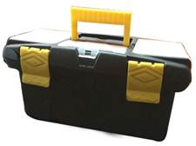
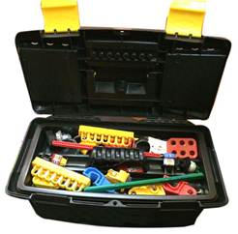
Safety EXPERTS
A UNIT OF SHIVA INDUSTRIAL CORPROTION
Item code - US-LOTO-ELEC-BOX-S-Rs.2500/-
Lockout Box– 1 pc
MCB Lockout – Different Models – 5 pcs
Dielectric Hasp – Yellow – 1 pc
Lockout Tag – 2 pcs
Lockout Ties – 2 pcs
Vinyl coated Hasp – Small - 1 pcs
Vinyl coated Hasp – Bigl - 1 pcs
Push Button Lockout – 1 pc
Padlock – Long shackle – 1 pc
Padlock – Regular shackle – 1 pc
Keyring – 2 pcs
Writing pen – 1 pc
Screw Driver – 1 pc
Handle Lockout – 1 pc
Pin Type MCB Lockout – different models - 3 pcs
Add: 4615-15, GROUND FLOOR, GALI SHAHTARA,, AJMERI GATE, DELHI-110006
E-mail : rahulsakhuja@yahoo.com TEL . : 011-23215050, Mob. No.9811048483

Slide 54
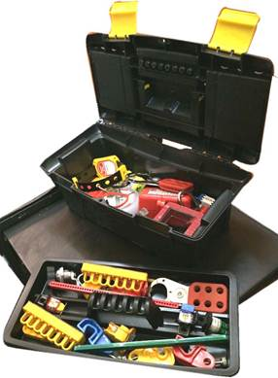
Safety EXPERTS
A UNIT OF SHIVA INDUSTRIAL CORPROTION
Item code - US-LOTO-ELEC-BOX-L-Rs.4275/-
Lockout Box– 1 pc
MCB Lockout – Different Models – 5 pcs
Dielectric Hasp – Yellow – 1 pc
Plug Lockout – Small
Electrical Bar Lockout – 1 set
LCB Lockout – 1 pc
Lockout Tag – 2 pcs
Lockout Ties – 2 pcs
Vinyl coated Hasp – Small - 1 pcs
Vinyl coated Hasp – Bigl - 1 pcs
Push Button Lockout – 1 pc
Padlock – Long shackle – 2 pc
Padlock – Regular shackle – 2 pc
Tie Bar Lockout – 1 pc.
Electrical Panel Lockout – Small Round – 1 pc
Electrical Panel Lockout – Small Square – 1 pc
Keyring – 2 pcs
Writing pen – 1 pc
Screw Driver – 1 pc
Handle Lockout – 1 pc
Pin Type MCB Lockout – different models - 3 pcs
Add: 4615-15, GROUND FLOOR, GALI SHAHTARA,, AJMERI GATE, DELHI-110006
E-mail : rahulsakhuja@yahoo.com TEL . : 011-23215050, Mob. No.9811048483

Slide 55

Safety EXPERTS
A UNIT OF SHIVA INDUSTRIAL CORPROTION
Item code - US-ELEC-LARGE-KIT – Rs.6100/-
Lockout Station – 1 pc
Handle Lockout – 1 pc
MCB Lockout – Different Models – 5 pcs
MCCB Lockout – 1pc
Pin Type MCB Lockout – 3 pcs
Bar Lockout – 1 pc
Cylinder Lockout – yellow – 1 pc
Plug Lockout – Small – 1 pc
Push Button Lockout – 1 pc
Big Multipurpose cable Lockout – 1 pc
Scissor Cable Lockout – 1 pc
Round Cable Lockout – 1 pc
Dielectric Hasp – Yellow – 1 pc
Double jaw Hasp – 1 pc
6 hole dielectric Hasp – 1 pc
Labeled Hasp – 1 pcs
Lockout Tag – 2 pcs
Vinyl coated Hasp – 2 pcs
Padlock – Long shackle – 3 pcs
Padlock – Regular shackle – 3 pcs
Add: 4615-15, GROUND FLOOR, GALI SHAHTARA,, AJMERI GATE, DELHI-110006
E-mail : rahulsakhuja@yahoo.com TEL . : 011-23215050, Mob. No.9811048483

Slide 56
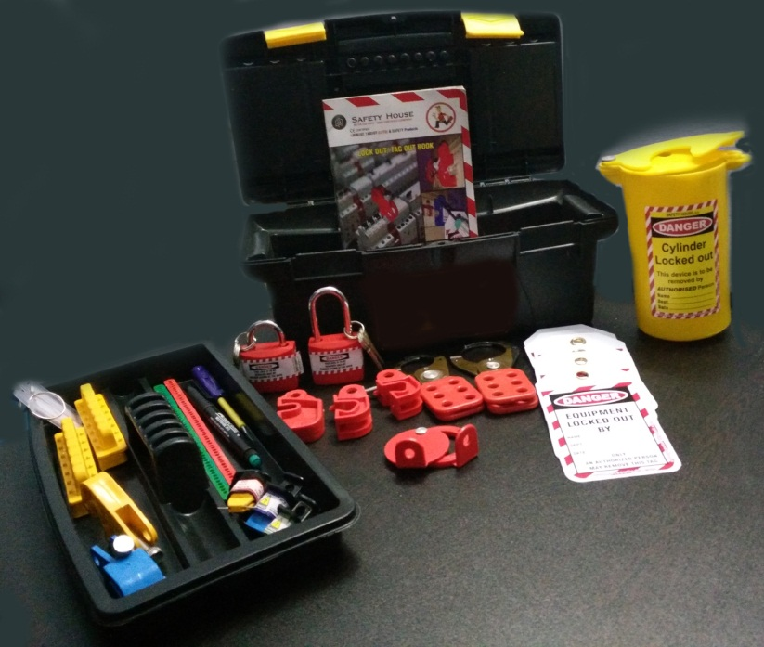
Safety EXPERTS
A UNIT OF SHIVA INDUSTRIAL CORPROTION
Item code - US-ELEC-Box-KIT-Rs.4000/-
Gate Valve Lockout – 02 – 1 pc
Cylinder Lockout – 1 pc
Plug Lockout – Small – 1 pc
Plug Lockout – Large – 1 pc
Rack In Out Lockout Device– 1 pc
Labeled Hasp – 1 pcs
Lockout Tag – 5 pcs
Vinyl coated Hasp – 2 pcs
Padlock – Long shackle – 1 pc
Padlock – Regular shackle – 1 pc
Lockout Sign =- 1 pc
Bar Lockout – 1 set
MCB Lockout – 3 pcs
Pin Type MCB Lockout – 3 pcs
Lockout Book – 1 pc
Writing pen – 1 pc
Screw Driver – 1 pc
Lockout Big Box
Add: 4615-15, GROUND FLOOR, GALI SHAHTARA,, AJMERI GATE, DELHI-110006
E-mail : rahulsakhuja@yahoo.com TEL . : 011-23215050, Mob. No.9811048483

Slide 57
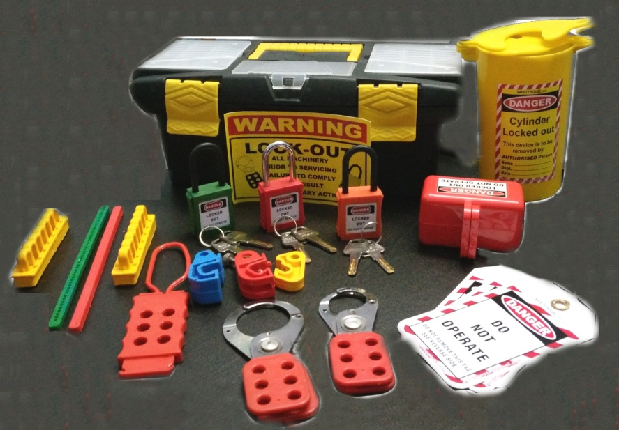
Safety EXPERTS
A UNIT OF SHIVA INDUSTRIAL CORPROTION
Item code - US-Elect / MECH Mix Box-KIT-Rs.3400/-
Cylinder Lockout – 1 pc
Plug Lockout – Small – 1 pc
Plug Lockout – Large – 1 pc
6 hole dielectric Hasp – 1 pc
Bar Lockout – 1 set
Lockout Tag – 2 pcs
Vinyl coated Hasp – 2 pcs
Round type cable Lockout – 1 pc
OSHA Padlock – Long shackle – 3 pcs
MCB Lockout – 3 pcs
Rack In Out Lockout device – 1 pc
Lockout Sign = 1 pc
Lockout Big Box
Add: 4615-15, GROUND FLOOR, GALI SHAHTARA,, AJMERI GATE, DELHI-110006
E-mail : rahulsakhuja@yahoo.com TEL . : 011-23215050, Mob. No.9811048483

Slide 58

Safety EXPERTS
A UNIT OF SHIVA INDUSTRIAL CORPROTION
Item code – US-JUMBO-Kit – Rs.15500/-
Add: 4615-15, GROUND FLOOR, GALI SHAHTARA,, AJMERI GATE, DELHI-110006
E-mail : rahulsakhuja@yahoo.com TEL . : 011-23215050, Mob. No.9811048483

Slide 59
Safety EXPERTS
A UNIT OF SHIVA INDUSTRIAL CORPROTION
Item code – JUMBO Kit
Lockout Beg Red - 1 Pc
Padlock long shackle different color – 10 pc
Padlock Regular shackle different color – 10 pc
Lockout hasp small- 2 pc
Lockout hasp big - 2 Pc
Dielectric hasp 6 hole – 2 Pc
MCB different model – 10 Pc
Round cable lockout - 2 Pc
Lockout Rack cover in round – 2 Pc
Scissor cable lockout – 2 Pc
MCCB lockout round upper – 2 Pc
Breaker lockout kit – 2 pc
Writing Pen – 2 Pc
Lockout Book – 2 Pc
EPL small Square shape – 2 pc
Lockout Register – 2 Pc
De – Electric yellow hasp – 2 Pc
EPL Small round shape – 2 Pc
EPL Large round shape – 2 Pc
EPL Extra large square shape – 2 Pc
Lockout Keyring – 21 Pc
MCCB large circuit breaker lockout – 2 Pc
Lockout Cylinder yellow color – 2 Pc
Plug lockout large – 2 Pc
Mini pneumatic lockout device – 2 Pc
Scaffolding tag made of rewritable – 10 Pc
Scaffolding tag holder – 1 Pc
Lockout tag printed – 10 Pc
Lockout Pin different color – 6 Pc
Padlock Eye medium size – 20 Pc
Padlock Eye lrage size – 10 Pc
Electrical Handle lockout – 2 Pc
Tie bar circuit breaker lockout – 2 Pc
Lockout Push button – 2 Pc
Big multipurpose cable lockout – 2 Pc
Lockout Tag Hasp – 2 Pc
Add: 4615-15, GROUND FLOOR, GALI SHAHTARA,, AJMERI GATE, DELHI-110006
E-mail : rahulsakhuja@yahoo.com TEL . : 011-23215050, Mob. No.9811048483

Slide 60

Safety EXPERTS
A UNIT OF SHIVA INDUSTRIAL CORPROTION
Item code – US-STANDARD-ELECTRICAL KIT – Rs.5400/-
Lockout Red Pouch – 1 pc
Padlock long shackle different color – 6 Pc
Lockout 6 hole hasp – 2
Di-Electric Yellow hasp – 2 pc
Big Multipurpose cable lockout- 2 pc
Plug lockout small – 2 pc
Plug lockout Large – 2 pc
Lockout Pen – 1 pc
Lockout Pin different model – 3 pc
UCB different model – 11 pc
Lockout Pen – 1 pc
Lockout Tie – 10 pc
Electrical Panel lockout small- 2 pc
Electrical panel lockout Small square – 1 pc
Electrical pane lockout big square – 2 pc
Handel lockout – 1 pc
Lockout yellow cylinder – 1 pc
Scissor cable lockout – 2 pc
Lockout Tag – 10 pc
Add: 4615-15, GROUND FLOOR, GALI SHAHTARA,, AJMERI GATE, DELHI-110006
E-mail : rahulsakhuja@yahoo.com TEL . : 011-23215050, Mob. No.9811048483

Slide 61

Safety EXPERTS
A UNIT OF SHIVA INDUSTRIAL CORPROTION
Item code - US-ELEC-STATION-LARGE-KIT – Rs.11900/-
Add: 4615-15, GROUND FLOOR, GALI SHAHTARA,, AJMERI GATE, DELHI-110006
E-mail : rahulsakhuja@yahoo.com TEL . : 011-23215050, Mob. No.9811048483

Slide 62
Safety EXPERTS
A UNIT OF SHIVA INDUSTRIAL CORPROTION
Item code – US-ELEC-STATION-LARGE-KIT
Lockout Red Station – 1 pc
Padlock long shackle diffrent color – 6 Pc
Padlock Regular shackle – 6 pc
Lockout 6 hole hasp – 2
Di-Electric Yellow hasp – 2 pc
Big Multipurpose cable lockout- 2 pc
Lockout big hasp red color – 3 pc
Lockout Small hasp – 3 pc
Lockout lable hasp – 2 pc
Round cble lockout - 2 pc
Lockout Pin different model – 6 pc
UCB different model – 11 pc
Lockout Rack cover in round shape – 2 pc
Electrical Panel lockout small round- 1 pc
Electrical panel lockout Small square – 1 pc
Electrical panel lockout big round – 1 pc
Electrical pane lockout big square – 1 pc
Large circuit breaker lockout – 1 pc
Large circuit breaker lockout round upper – 1 pc
Lockout Book – 1 pc
Lockout Register – 1 pc
Bar lockout – 2 pc
Push button lockout – 1 pc
Lockout Scaffold tag – 1 pc
Lockout Scaffold Tag holder – 1 pc
Lockout padlock Eye Buffer – 1 pc
Padlock eye small / large size - pc
Handle lockout – 1 pc
Lockout Tag – 2 pc
Tie bar lockout - 2 pc
Scissor cable lockout – 2 pc
Add: 4615-15, GROUND FLOOR, GALI SHAHTARA,, AJMERI GATE, DELHI-110006
E-mail : rahulsakhuja@yahoo.com TEL . : 011-23215050, Mob. No.9811048483

Slide 63

Safety EXPERTS
A UNIT OF SHIVA INDUSTRIAL CORPROTION
Item code – Large Circuit Breaker Lockout Kit – Rs.4150/-
Yellow pouch - 1
Padlock long shackle diffrent color – 3 Pc
Padlock regular shackle different – 6 PC
Lockout Bravo lock – 3 pc
Lockout 6 hole hasp – 2 PC
Di-Electric Yellow hasp – 2 pc
Lockout big hasp red color – 1 pc
Lockout Small hasp – 1 pc
Lockout Pin different model – 3 pc
UCB different model – 10 pc
Lockout Tag – 10 pc
Lockout Tie – 10 pc
Lockout Pen – 1 pc
LCB Lockout – 2 pc
Lockout Book – 1 pc
Lockout Bar – 2 pc
Lockout Keyring – 3 pc
Add: 4615-15, GROUND FLOOR, GALI SHAHTARA,, AJMERI GATE, DELHI-110006
E-mail : rahulsakhuja@yahoo.com TEL . : 011-23215050, Mob. No.9811048483

Slide 64
Safety EXPERTS
A UNIT OF SHIVA INDUSTRIAL CORPROTION
Item code - US-ELEC-LARGE-KIT – Rs. 3000/-
Lockout Red Bag – 1 pc
Padlock long shackle yellow red color – 3 Pc
Lockout Small hasp – 4 pc
UCB Yellow lockout – 1 pc
Lockout handle – 3 pc
Lockout push button – 1 pc
Lockout Tag – 10 pc
Round cable lockout – 3 pc
Big Multipurpose lockout – 2 pc
Rack cover lockout – 1 pc
Add: 4615-15, GROUND FLOOR, GALI SHAHTARA,, AJMERI GATE, DELHI-110006
E-mail : rahulsakhuja@yahoo.com TEL . : 011-23215050, Mob. No.9811048483

Slide 65

Safety EXPERTS
A UNIT OF SHIVA INDUSTRIAL CORPROTION
Item code – US-HANDY-ELECTRICAL KIT – Rs. 2000/-
Lockout Red Bag – 1 pcs
Padlock small shackle – 1 Pcs
Di-Electric Padlock – 1 pcs
Lockout Small hasp – 4 pcs
MCB Lockout Different Model - 5 pcs
Lockout Tag – 10 pcs
Tie Bar Lockout – 1 pcs
Pin In / Out Type Lockout – 3 pcs
Writing Pen – 1 pcs
Di –Electric 6 hole hasp – 1 pcs
Snap on Breaker Lockout – 1 pcs
Add: 4615-15, GROUND FLOOR, GALI SHAHTARA,, AJMERI GATE, DELHI-110006
E-mail : rahulsakhuja@yahoo.com TEL . : 011-23215050, Mob. No.9811048483

Slide 66

Safety EXPERTS
A UNIT OF SHIVA INDUSTRIAL CORPROTION
Item code – US-ELECTRICIAN-LOTO-KIT – Rs. 2600/-
Lockout Yellow Pouch – 1 pcs
Di – Electric Padlock – 3 Pcs
MCB Lockout Different Model - 7 pcs
Lockout Tag – 10 pcs
Scissor Lockout – 1 pcs
Writing Pen – 1 pcs
Screw Driver - 1 pcs
Di –Electric 6 hole hasp – 3 pcs
Lockout fuse – 1 pcs
Lockout Tie – 10 pcs
Add: 4615-15, GROUND FLOOR, GALI SHAHTARA,, AJMERI GATE, DELHI-110006
E-mail : rahulsakhuja@yahoo.com TEL . : 011-23215050, Mob. No.9811048483

Slide 67

Safety EXPERTS
A UNIT OF SHIVA INDUSTRIAL CORPROTION
Item code – US-ELECTRICAL-PERSONAL-KIT – Rs.3400/-
Lockout Belt Pouch – 1 pcs
Di – Electric Padlock – 3 Pcs
MCB Lockout Different Model - 7 pcs
Lockout Tag – 10 pcs
Round cable Lockout – 1 pcs
Writing Pen – 1 pcs
Screw Driver - 1 pcs
Di –Electric 6 hole hasp – 1 pcs
Lockout fuse – 1 pcs
Lockout Hasp small – 1 pcs
Di – Electric Yellow Hasp – 1 pcs
Electrical Handle Lockout – 1 pcs
Push Button Lockout – 1 pcs
Loto Book – 1 pcs
Circuit Breaker Lockout – 1 pcs
Rackout Cover – 1 pcs
Pin Different model – 3 pcs
Add: 4615-15, GROUND FLOOR, GALI SHAHTARA,, AJMERI GATE, DELHI-110006
E-mail : rahulsakhuja@yahoo.com TEL . : 011-23215050, Mob. No.9811048483

